Slide 1
CSRS and FERS
A Guide for Employees
Approaching Retirement

Slide 2
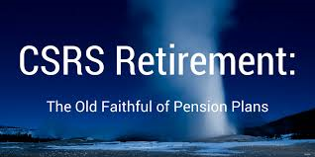
Civil Service Retirement System (CSRS)
CSRS effective August 1920
A defined benefit plan (you get a guaranteed amount in retirement no matter what the stock market does)
Notes:
CSRS-The Civil Service Retirement Act, which became effective on August 1, 1920, established a retirement system for certain Federal employees. The Civil Service Retirement System (CSRS) is a defined benefit, contributory retirement system. Employees share in the expense of the annuities to which they become entitled. CSRS covered employees contribute 7, 7 1/2 or 8 percent of pay to CSRS and, while they generally pay no Social Security retirement, survivor and disability (OASDI) tax, they must pay the Medicare tax (currently 1.45 percent of pay). The employing agency matches the employee's CSRS contributions.
CSRS employees may increase their earned annuity by contributing up to 10 percent of the basic pay for their creditable service to a voluntary contribution account. See Chap 31 & SF2804.
Employees may also contribute a portion of pay to the Thrift Savings Plan (TSP). There is no Government contribution, but the employee contributions are tax-deferred. For more information about TSP, see the TSP website.

Slide 3
Federal Employees Retirement System (FERS)
FERS effective 1/1/1987 (applies retroactively to new hires on and after 1/1/1984)
3 components:
Basic Benefit Plan (+ Special Annuity Supplement)
A defined benefit plan
Social Security
Thrift Savings Plan (up to 5% matching)
A defined contribution plan (the amount you get in retirement depends on how much you contribute, your investment choices, and stock market performance)
Notes:
FERS-Congress created the Federal Employees Retirement System (FERS) in 1986, and it became effective on January 1, 1987. Since that time, new Federal civilian employees who have retirement coverage are covered by FERS.
FERS is a retirement plan that provides benefits from three different sources: a Basic Benefit Plan, Social Security, and the Thrift Savings Plan (TSP). Two of the three parts of FERS (Social Security and the TSP) can go with you to your next job if you leave the Federal Government before retirement. The Basic Benefit and Social Security parts of FERS require you to pay your share each pay period. Your agency withholds the cost of the Basic Benefit and Social Security from your pay as payroll deductions. Your agency pays its part too. Then, after you retire, you receive annuity payments each month for the rest of your life.
The TSP part of FERS is an account that your agency automatically sets up for you. Each pay period your agency deposits into your account amount equal to 1% of the basic pay you earn for the pay period. You can also make your own contributions to your TSP account and your agency will also make a matching contribution. These contributions are tax-deferred. The Thrift Savings Plan is administered by the Federal Retirement Thrift Investment Board.

Slide 4
Retirement System Statistics
USPS Career Employment Jan. 2020
FERS 475,902 96.6%
CSRS 17,030 3.4%
Total 492,932

Slide 5
Types of Retirement
• Regular/Optional (Immediate/Voluntary)
• Early/MRA + 10 (FERS only)
• Deferred
• Disability
• AFA, or Alternative Form of Annuity
• “Early Out” (VER) (not applicable at this time)
• Phased (not applicable to USPS at this time)

Slide 6
This seminar focuses on
Regular (Immediate) Retirement
NALC members considering MRA+10, disability, or other types of retirement should obtain direct one-on-one advice from a branch officer, their NBA office, or the NALC HQ retirement department.

Slide 7
Three Primary Factors Determine
When you can retire
+
How much you will receive:
Age
Years of Service
High-Three Average Annual Salary

Slide 8
When Will I Be Eligible to Retire? This depends on your AGE and Years of Service
Notes:
FERS-Congress created the Federal Employees Retirement System (FERS) in 1986, and it became effective on January 1, 1987. Since that time, new Federal civilian employees who have retirement coverage are covered by FERS.
FERS is a retirement plan that provides benefits from three different sources: a Basic Benefit Plan, Social Security, and the Thrift Savings Plan (TSP). Two of the three parts of FERS (Social Security and the TSP) can go with you to your next job if you leave the Federal Government before retirement. The Basic Benefit and Social Security parts of FERS require you to pay your share each pay period. Your agency withholds the cost of the Basic Benefit and Social Security from your pay as payroll deductions. Your agency pays its part too. Then, after you retire, you receive annuity payments each month for the rest of your life.
The TSP part of FERS is an account that your agency automatically sets up for you. Each pay period your agency deposits into your account amount equal to 1% of the basic pay you earn for the pay period. You can also make your own contributions to your TSP account and your agency will also make a matching contribution. These contributions are tax-deferred. The Thrift Savings Plan is administered by the Federal Retirement Thrift Investment Board.

Slide 9
Age and Service Requirements for Regular/Optional Retirement
CSRS
FERS
Age
Service
Age
Service
55
30 years
MRA
30 years
60
20 years
60
20 years
62
5 years
62
5 years
MRA
10 years*
(*reduced benefits)
Notes:
CSRS:
In order to retire voluntarily you must meet both the age and service requirements outlined in this slide.
Once you meet these requirements you can retire at any time.
Generally, your benefits will begin on the first of the month after you retire unless you retire within the first three days of the month. If you retire within the first 3 days of the month your benefits will begin on the day after you retire.
FERS:
The minimum retirement age starts at age 55 and gradually increases until age 57 depending on your year of birth.
Under FERS you may also retire on a regular retirement once you reach your MRA provided you have at least 10 years of service. If you retire under the MRA + 10 provision, your retirement benefit will be subject to an age reduction that equals 5% for each year you are under age 62 at the time your benefits begin.
Under FERS your benefits will generally begin on the first of the month unless you retire under the MRA + 10 provision. If you retire under the MRA + 10 provision, you may choose to postpone receiving your benefits until a later date to reduce or eliminate the age reduction.
Age Reduction If you have 10 or more years of service and are retiring at the Minimum Retirement Age, your annuity will be reduced for each month that you are under age 62. The reduction is 5% per year (5/12 of a percent per month). However, your annuity will not be reduced if you completed at least 30 years of service, or if you completed at least 20 years of service and your annuity begins when you reach age 60. You can reduce or eliminate this age reduction by postponing the beginning date of your annuity.
Postponing the Beginning Date of Annuity to Reduce or Avoid the Age Reduction
You can reduce or eliminate the age reduction if you choose to have your annuity begin at a date later than the Minimum Retirement Age (MRA). You can choose any beginning date between your MRA and 2 days before your 62nd birthday. However, you cannot begin your annuity while you are reemployed.
If you postpone the beginning date of your annuity, you should be aware of the following—
Life Insurance You cannot continue your life insurance coverage unless you are receiving an annuity. Therefore, if you Postpone the beginning date of your annuity, your life insurance enrollment will terminate. When your annuity begins, the life insurance coverage you had when you separated from your employment will resume.
Health Insurance If you postpone the beginning date of your annuity, you will be eligible to temporarily continue your health benefits coverage for 18 months from the date of separation from your employing agency; however, you must contact your agency within 60 days and pay the total premium, plus a 2% administrative charge. When your annuity payments begin, you will again have the opportunity to enroll in a health benefits plan under the regular Federal Employees Health Benefits Program, and OPM will pay the Government share of the premium.
Federal Long Term Care Insurance If you already have Long Term Care Insurance Coverage when you separate for retirement, but postpone the commencing date of your annuity, your coverage will continue as long as you continue to pay premiums. If you are not enrolled in the Federal Long Term Care Insurance Program when you separate for retirement, you can apply for enrollment anytime after your separation, even if you postpone the commencing date of your annuity.
COLAs If you delay your annuity beginning date, your annuity rate will not include any cost-of-living adjustments (COLAs) that occur before you begin to receive the annuity. Once your annuity begins, you will be entitled to COLAs on any portion of your annuity which was computed under CSRS rules. However, you will not receive COLAs on the FERS part of your benefit until you are 62.
Survivor Benefits If you defer receipt of your annuity and die before you begin to receive it, your spouse can still receive FERS survivor benefits.
NOTE: Under certain conditions, active duty military service may count toward the 30 year, 20 year or 10 year requirements. We will discuss this a little later.

Slide 10
The Minimum Retirement Age* is determined as follows:
If you were born
Your MRA is
Before 1948 55 years
In 1948 55 years, 2 months
In 1949 55 years, 4 months
In 1950 55 years, 6 months
In 1951 55 years, 8 months
In 1952 55 years, 10 months
In 1953 to 1964 56 years
In 1965 56 years, 2 months
In 1966 56 years, 4 months
In 1967 56 years, 6 months
In 1968 56 years, 8 months
In 1969 56 years, 10 months
In 1970 and after 57 years
*Applies to FERS only
Notes:
The Minimum Retirement Age is determined as follows:
Before 1948, 55 years
1948- 55 years, 2 months
1949- 55 years, 4 months
1950-55 years, 6 months
1951- 55 years, 8 months
1952- 55 years, 10 months
1953 to 1964, 56 years
1965- 56 years, 2 months
1966- 56 years, 4 months
1967- 56 years, 6 months
1968- 56 years, 8 months
1969- 56 years, 10 months
1970 and after, 57 years

Slide 11
Amount of Creditable Service
for purposes of Eligibility
Years worked under CSRS or FERS
plus
Years of Military Service*
plus
Years of Non-Career Federal Service*
*when eligible and required deposit made
Notes:
Everyone’s service history is different. It’s not like it used to be where you are hired under CSRS and continue to work for 30-40 years with the Federal Gov’t.
(See Chap 20)
Factors include:
Non-deduction or temporary time
Service under another retirement plan for Federal employees
Part time, Full-time, Intermittent time
Questionable service

Slide 12
Amount of Creditable Service: Unused Sick Leave counts towards how much you get but not eligibility
Sick leave is not creditable for establishing retirement eligibility
Sick leave balance at retirement is added to the length of service to calculate the amount of an immediate annuity
Notes:
As a result of the NDAA of FY 2010, FERS SL was allowed to be added to the annuity computation.

Slide 13
Amount of Creditable Service:
LWOP may reduce service credit
Cumulative LWOP in excess of 6 months in a calendar year is not credited for eligibility or computation purposes.
In other words, the first six months of cumulative leave without pay per calendar year IS credited.
Exceptions: All Leave Without Pay is credited if the LWOP was due to an on-the-job injury and wage loss compensation was paid by OWCP, or LWOP is due to full-time union official employment and union pays employer contributions, or LWOP is due to military furlough

Slide 14
Amount of Creditable Service:
Proration for part time service
•In determining eligibility to retire, part time service is creditable to the same extent as full time service for both CSRS and FERS
CSRS - part time service prior to 4/7/86 is treated as full time for annuity calculation
•CSRS - part time service on and after 4/7/86 is prorated for annuity calculation
•FERS – all part time service is prorated for annuity calculation
Notes:
ELM 582.3 Part-Time Service
Retirement benefits that include part-time employment will be prorated by a ratio of the part-time hours worked to the number of hours a full-time employee would have worked.
Compute the actual time worked, and the number of full-time hours that could have been worked, for all periods of part time service (performed on or after April 7, 1986 for CSRS).
Include time worked in excess of the scheduled part-time tour of duty, not to exceed full-time credit, in the computation of the actual time worked.
Include periods of creditable time in a nonpay (LWOP) status in the computation of actual time worked. The "actual time worked" during nonpay status is based on the tour of duty in effect immediately before entry into the nonpay status.
Divide the total actual hours worked by the total full-time hours to obtain the CSRS proration factor (round to the nearest percent).
You can request an annuity estimate from USPS Shared Services that includes calculation of part time service.
See section 5 of the Blue Book – General retirement information Question 4 in the CSRS book, question 11 in the FERS book:
The high-3 calculation for part-time employees may differ; such employees may request a NARECS annuity estimate through the HR Shared Service Center and the high-3 amount will be shown on it

Slide 15
Crediting Military Service
Must be Active Duty Service with Discharge Under Honorable Conditions
If Receiving Military Retired Pay, Must Waive it - Unless it is Based on 1) Disability Incurred in Combat or 2) National Guard Service
National Guard Service is
Generally Not Creditable

Slide 16
Do I need to make a deposit for post-1956 military service?
CSRS |  | FERS
Credit for Eligibility | Credit for Annuity | Credit for Eligibility | Credit for Annuity
No | It Depends | Yes | Yes

Slide 17
Crediting Military Service
Military Service prior to January 1, 1957 is creditable for retirement eligibility and computation, without making deposit, under both CSRS & FERS.
Military Service after 1956 may be creditable based on various factors, including whether deposit has been made prior to separation

Slide 18
Crediting Post-1956 Military Service - CSRS -
If first employed in a position covered by CSRS on or after 10/01/82, must make deposit to obtain credit for eligibility and calculation.
If first employed in a position covered by CSRS before 10/01/82, and if retiring prior to age 62, may receive credit without making deposit.
However, if no deposit is made, the annuity will be reduced at age 62, if the retiree is eligible for Social Security benefits; this is called “Catch 62”. If the retiree is not eligible for Social Security benefits at age 62, there is no reduction in annuity.

Slide 19
Crediting Post-1956 Military Service - CSRS -
If first employed in a position covered by CSRS before 10/01/82, and if retiring on or after age 62, can receive credit for purposes of annuity calculation if eligible for Social Security benefits only if deposit was made
However, the military service may be creditable for establishing eligibility to retire even if no deposit is made.

Slide 20
Crediting Post-1956 Military Service - FERS -
Post-1956 Military Service is creditable (for purposes of eligibility to retire and for purposes of calculation of annuity) under FERS only if deposit is made.

Slide 21
Crediting Post-1956 Military Service
CSRS
FERS
Military deposit equals 7% of base military pay plus interest*
Military deposit equals 3% of base military pay plus interest*
*interest does not start to accrue for the first 2 years of civilian service in most cases

Slide 22
How to Make Deposit for Military Service
Call USPS Shared Services: 877-477- 3273 (Option 5)
Complete SF 2803A (if CSRS) or
Complete SF 3108A (if FERS)
Submit completed SF with DD 214
Full deposit must be made to USPS prior to separation.

Slide 23
Crediting Non-Career Federal Service
CSRS
FERS
Service <10/1/82:
Credited, but annuity reduced if no deposit
Service >10/1/82:
credited for eligibility automatically; credited for computation only if deposit is made
Service < 1/1/89:
Credited only if deposit made
Service > 1/1/89:
Not creditable*
*Transitional Employee category first created 1992

Slide 24
Cost to Credit Non-Career Federal Service
CSRS
FERS
Generally, 7% of basic pay of the non-career service, plus interest
Generally, 1.3% of basic pay of the non-career service, plus interest

Slide 25
How to Make Deposit for Non-Career Federal Service
Call USPS Shared Services: 877-477- 3273 (Option 5)
Complete SF 2803 (CSRS) or
Complete SF 3108 (FERS)
Deposit can be made to USPS prior to separation or directly to OPM after separation.

Slide 26
How Much Will I Get?
Annuity Computation
Notes:
Who can tell me what is involved in calculating the annuity?

Slide 27
Years of Service
x
High-Three Average Annual Salary
x
Appropriate Formula

Slide 28
Amount of Creditable Service for purposes
of how much you get:
Years worked under CSRS or FERS
plus
Years of Military Service*
plus
Years of Non-Career Federal Service*
plus
Banked Sick Leave**
minus
LWOP in excess of 6 months in a calendar year***
*when eligible and required deposit made
**SL counts towards how much you get but not eligibility
***Unless LWOP is due to on-the-job injury and OWCP pays wage-loss compensation, or LWOP is due to full-time union employment and union pays employer contributions

Slide 29
OPM calculates years and months only
OPM calculates amount of annuity using years and months; days short of a month (30) are dropped.
Notes:
HANDOUTS #1 & 2
CSRS FERS Handbook 50A2.1-2B https://www.opm.gov/retirement-services/publications-forms/csrsfers-handbook/c050.pdf See p.5
Calculating Length of Service
Length of service for annuity computation purposes is based on whole months (30 days). To determine the total length of service for annuity computation purposes, add all creditable civilian and military service and the period represented by the unused sick leave; then eliminate any fractional part of a month.

Slide 30
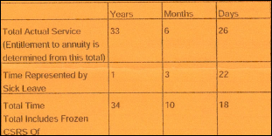
Test your understanding
Example 1: Service days and Sick Leave
days add up to 27. They do not add up to
30 to equal one month; therefore they are
dropped.
Exercise: Using the Sick Leave Conversion Chart on Handout 2, convert 649 hours of unused sick leave (USL) into months and days.
Example 2: Service days &
USL days add up to 48;
therefore, credit is given for
one _____ and what happens
with the 18 days?
Notes:
HANDOUTS #1 AND 2
Exercise: Using the Sick Leave Conversion Chart on Handout 2, convert 649 hours of unused sick leave (USL) into months and days.
Answer: 3 months and 22 days
Example 2: Service days & USL days add up to 48; therefore, credit is given for one month and what happens with the 18 days? A: days are dropped, but note they are not dropped until after they have been combined with service days

Slide 31
High-3 Average Salary
$
$
$
3 Consecutive Years of Basic Pay
Notes:
The high 3 average salary is the highest pay obtained by averaging the rates of basic pay in effect during any 3 consecutive years of service, with each rate weighted by the time it was in effect.
The 3 years need not be continuous, but they must consist of consecutive period of service. Two or more separate periods of employee that follow each other my be combined to make up the 3 years of service.
The 3 year period may start and end on whichever dates give the highest 3 years of basic pay. Since employee pay usually increases the longer you work, the high-3 usually occurs during the last 3 years of service. However, any 3 years will be used if it produces a higher average salary.
A break of 3 calendar days or less will be used to compute the high-3.
LWOP status for 6 months or less may be used in the high-3, however, LWOP over 6 months will not be used to compute the high-3.
Military pay will not be used in computing the high-3 unless the military service interrupts the civilian service and the employee exercises reemployment or restoration rights, civilian pay is projected over the period of military service and used to compute the high-3.

Slide 32
Sample High-3 calculation from USPS annuity estimate: Total-3 Average Salary Total: 64,228
Salary History From To Yrs Mns Days Annual Rate Gross Pay
08/31/2019 02/01/2020 0 5 0 66,403 27,667
11/24/2018 08/31/2019 0 9 7 65,766 50,603
09/01/2018 11/24/2018 0 2 23 64,413 14,850
03/03/2018 09/01/2018 0 5 28 63,768 31,529
11/25/2017 03/03/2018 0 3 8 63,248 17,217
09/02/2017 11/25/2017 0 2 23 62,454 14,399
03/04/2017 09/02/2017 0 5 28 62,184 30,746
02/01/2017 03/04/2017 0 1 3 61,851 5,669
Notes:
HANDOUT #3

Slide 33
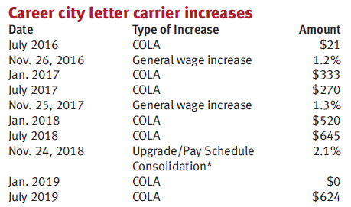

Slide 34
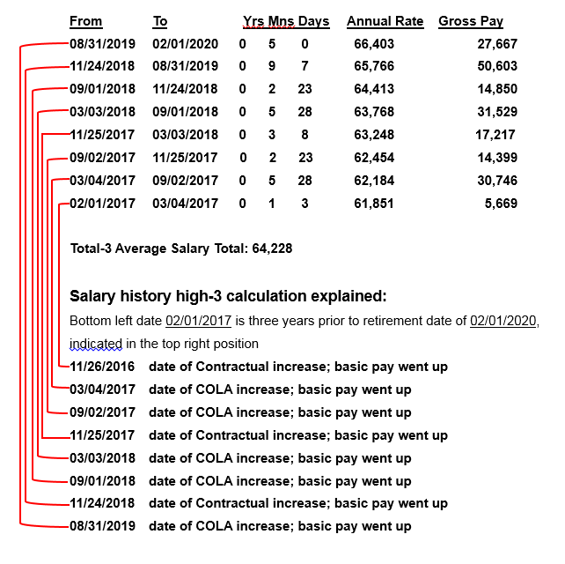
High-3 calculation from USPS annuity estimate:
Notes:
HANDOUT #3

Slide 35
High-3 Average Salary
Basic Pay Does Not Include:
Bonuses
Overtime
Night differential
Notes:
https://www.opm.gov/retirement-services/publications-forms/csrsfers-handbook/c050.pdf See p.12

Slide 36
General Formula
CSRS
FERS
1.5% x 5 years +
1.75%x 5 years +
2% x service over
10 years
1% or 1.1%* x years of service
*1.1% if age 62 (or older) with 20 (or more) years
Notes:
The general formula is used to compute basic annuities for voluntary, early voluntary, discontinued service, and deferred retirements. It is also used to compute disability retirements when the employee is over age 60 or the earned annuity is greater than the disability guaranteed minimum.
Under FERS, the general formula applies to the FERS component of an employee who transferred to FERS. While the CSRS general formula would apply to the CSRS component of an employee who transferred to FERS.

Slide 37
General Formula
30 Years Total Service
CSRS
FERS
1.5% x 5
=
7.50%
1 % x 30 = 30%
or
1.75% x 5
=
8.75%
2.0% x 20
40.00%
=
56.25%
1.1% x 30 = 33%
Notes:
Chapter 50, see Charts

Slide 38
FOR REVIEW: Age and Service Requirements for Regular/Optional Retirement
CSRS
FERS
Age
Service
Age
Service
55
30 years
MRA
30 years
60
20 years
60
20 years
62
5 years
62
5 years
MRA
10 years*
(*reduced benefits)
Notes:
CSRS:
In order to retire voluntarily you must meet both the age and service requirements outlined in this slide.
Once you meet these requirements you can retire at any time.
Generally, your benefits will begin on the first of the month after you retire unless you retire within the first three days of the month. If you retire within the first 3 days of the month your benefits will begin on the day after you retire.
FERS:
The minimum retirement age starts at age 55 and gradually increases until age 57 depending on your year of birth.
Under FERS you may also retire on a regular retirement once you reach your MRA provided you have at least 10 years of service. If you retire under the MRA + 10 provision, your retirement benefit will be subject to an age reduction that equals 5% for each year you are under age 62 at the time your benefits begin.
Under FERS your benefits will generally begin on the first of the month unless you retire under the MRA + 10 provision. If you retire under the MRA + 10 provision, you may choose to postpone receiving your benefits until a later date to reduce or eliminate the age reduction.
Age Reduction If you have 10 or more years of service and are retiring at the Minimum Retirement Age, your annuity will be reduced for each month that you are under age 62. The reduction is 5% per year (5/12 of a percent per month). However, your annuity will not be reduced if you completed at least 30 years of service, or if you completed at least 20 years of service and your annuity begins when you reach age 60. You can reduce or eliminate this age reduction by postponing the beginning date of your annuity.
Postponing the Beginning Date of Annuity to Reduce or Avoid the Age Reduction
You can reduce or eliminate the age reduction if you choose to have your annuity begin at a date later than the Minimum Retirement Age (MRA). You can choose any beginning date between your MRA and 2 days before your 62nd birthday. However, you cannot begin your annuity while you are reemployed.
If you postpone the beginning date of your annuity, you should be aware of the following—
Life Insurance You cannot continue your life insurance coverage unless you are receiving an annuity. Therefore, if you Postpone the beginning date of your annuity, your life insurance enrollment will terminate. When your annuity begins, the life insurance coverage you had when you separated from your employment will resume.
Health Insurance If you postpone the beginning date of your annuity, you will be eligible to temporarily continue your health benefits coverage for 18 months from the date of separation from your employing agency; however, you must contact your agency within 60 days and pay the total premium, plus a 2% administrative charge. When your annuity payments begin, you will again have the opportunity to enroll in a health benefits plan under the regular Federal Employees Health Benefits Program, and OPM will pay the Government share of the premium.
Federal Long Term Care Insurance If you already have Long Term Care Insurance Coverage when you separate for retirement, but postpone the commencing date of your annuity, your coverage will continue as long as you continue to pay premiums. If you are not enrolled in the Federal Long Term Care Insurance Program when you separate for retirement, you can apply for enrollment anytime after your separation, even if you postpone the commencing date of your annuity.
COLAs If you delay your annuity beginning date, your annuity rate will not include any cost-of-living adjustments (COLAs) that occur before you begin to receive the annuity. Once your annuity begins, you will be entitled to COLAs on any portion of your annuity which was computed under CSRS rules. However, you will not receive COLAs on the FERS part of your benefit until you are 62.
Survivor Benefits If you defer receipt of your annuity and die before you begin to receive it, your spouse can still receive FERS survivor benefits.
NOTE: Under certain conditions, active duty military service may count toward the 30 year, 20 year or 10 year requirements. We will discuss this a little later.

Slide 39
Test Your Knowledge: CSRS
Employee has 30 years of service (Full Time) and the high-3 average salary is $64,228
1.5% of $64,228 x 5 years = $ 4,_ _ _
_._ _% of $64,228 x 5 years = $ 5,620
2.0% of $64,228 x _ _ years = $25,691
Basic Annuity (per year) = $ _ _,_ _ _
Notes:
HANDOUT #4
1.5% of $64,228 x 5 years = $ 4,817
1.75% of $64,228 x 5 years = $ 5,620
2.0% of $64,228 x 20 years = $25,691
Basic Annuity (per year) = $36,128

Slide 40
Test Your Knowledge: FERS Example 1
Employee, age MRA of 57, has 30 years of service (Full Time) and High-3 average salary of $64,228
_._% of $_ _,_ _ _ x 30 = $19,_ _ _
Eligible for the FERS Special Annuity Supplement
Notes:
HANDOUT #5
1.0% of $64,228 x 30 = $19,268
or
1% x 30 = 30%
30% x $64,228 = $19,268

Slide 41
Test Your Knowledge: FERS Example 2
Employee, age 62, has 30 years of service (Full Time) and high-3 average salary of $64,228
*use appropriate age 62 and ≥ 20y formula
**FERS Special Annuity Supplement not payable after 62
_._% of $_ _,_ _ _ x 30 = $_ _,_ _ _
Notes:
HANDOUT #6
1.1% of $64,228 x 30 = $21,195
or
1.1% x 30 = 33%
33% x $64,228 = $21,195

Slide 42
FERS Age Reduction MRA + 10 Retirement
Employee has MRA and at least 10 years of service but less than 30 (& also does not have age 60 with ≥ 20 years of service) and begins receiving annuity before age 62.
Doubly undesirable:
There is an age reduction of 5% for each full year under age 62 and it’s permanent
FERS Special Annuity Supplement is not paid
Notes:
The annuity of an employee who retires under early deferred or MRA + 10 provisions is reduced by five-twelfths of 1 percent for each full month (5 percent a year) the employee is under age 62 at the commencing date of the annuity.

Slide 43
Test Your Knowledge: FERS Example 3
MRA+10 (reduced) retirement
a.k.a. the FERS Age Reduction
Employee age MRA of 56 has 29 years, 11 months of service (Full Time) and high-3 average salary of $64,228
1% of $64,228 x 29 11/12 = $19,215
Minus 5% for each year under age 62
_ _% of $19,215 = $_,_ _ _
$19,215 - $_,_ _ _ = $_ _,_ _ _
Notes:
HANDOUT #7
1% of $64,228 x 29 11/12 = $19,215
(difference between 29 & 11/12 vs. 30 years of service is $52/year or $4.33/month)
Minus 5% for each year under age 62
5% x 6 = 30% 30% of $19,215 = $5,765
$19,215 - $5,765 = $13,450

Slide 44
FERS Special Annuity Supplement
Intended to substitute for the Social Security part of the total FERS benefit until age 62
Approximates the Social Security benefit earned under FERS
It is paid by OPM, not Social Security
Subject to earnings test
No COLAs
Ends at age 62
Notes:
The FERS Annuity Supplement is paid to certain FERS employees who retire before age 62. The supplement is an estimate of the amount of Social Security benefits earned during FERS civilian service.
If you retire before you reach age 62, you will be able to receive your FERS Basic Benefit, and if you choose, your Thrift Savings Plan benefit. You will not be able to receive your Social Security benefit until you reach age 62. However, you may qualify to receive the FERS Annuity Supplement until you reach age 62.
FERS Annuity Supplement---Chapter 51
Substitutes for the Social Security part of the total FERS benefit until you reach age 62.
Approximates the SS benefit earned while you worked under FERS.
Subject to the Social Security earnings test. If you work after retirement, your post-retirement earning could reduce or eliminate your FERS Supplement. The 2020 SS earnings limitation is $18,240. No COLAs

Slide 45
FERS Special Annuity Supplement (SAS)
To be eligible for the Supplement:
Employee must have 1 full calendar year of deductions under FERS, and
Must qualify for an immediate, unreduced, non-disability retirement
MRA+10 retirement does not receive Special Annuity Supplement
Notes:
You can receive this supplement if you have worked under FERS for at least 1 calendar year, and you retire on an immediate, non-disability annuity (other than the “MRA + 10” retirement provision).
If you retire before you reach your MRA under an Early Optional or Discontinue Service Retirement, you have to wait until your MRA before you start receiving the Supplement.

Slide 46
Special Annuity Supplement (SAS)
Subject to earnings test.
Earnings are wages, including self-employment.
Earnings do not include investment gains, interest, pensions, TSP withdrawals, etc.
If you earn more than $18,240* in 2020, SAS will be reduced in 2021 by $1 for each $2 earned above that $18,240.
Must report earnings each year to OPM.
* Exempt amount may increase each year and is aligned with Social Security earnings limitation.

Slide 47
Calculate Approximate Estimate of Special Annuity Supplement
Get Social Security estimate of projected age-62 benefit
Multiply by years of FERS coverage (rounded to nearest whole number)
DO NOT INCLUDE BANKED SICK LEAVE, MILITARY, ETC
Divide by 40
*One fault to this method is that Social Security estimate wages include overtime. The actual computation is done by OPM, is not based on Social Security’s estimate, is based only on FERS earnings and doesn’t include OT.
Notes:
HANDOUT #8
You can receive this supplement if you have worked under FERS for at least 1 calendar year, and you retire on an immediate, non-disability annuity (other than the “MRA + 10” retirement provision).
If you retire before you reach your MRA under an Early Optional or Discontinued Service Retirement, you have to wait until your MRA before you start receiving the Supplement.

Slide 48
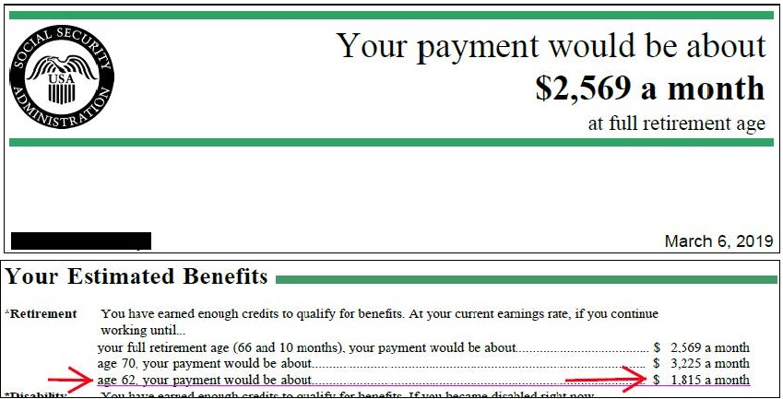
Sample Calculation of Special Annuity Supplement Using Ballpark Formula
Social Security projected age-62 benefit is
$1,815 X 31 years under FERS / 40 = $1,406
Notes:
You can receive this supplement if you have worked under FERS for at least 1 calendar year, and you retire on an immediate, non-disability annuity (other than the “MRA + 10” retirement provision).
If you retire before you reach your MRA under an Early Optional or Discontinue Service Retirement, you have to wait until your MRA before you start receiving the Supplement.

Slide 49
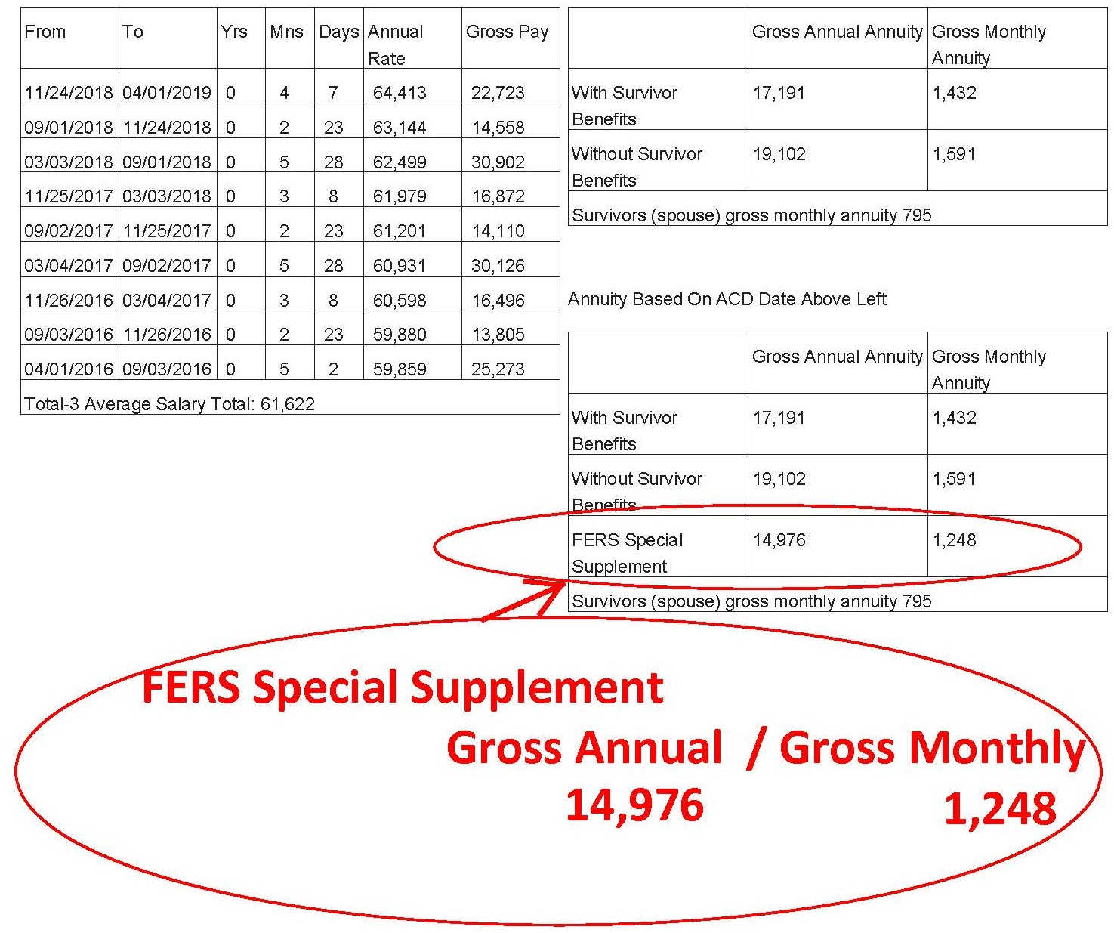
Notes:
HANDOUT #9
Beginning about Fall 2017, the Postal Service revised its retirement estimate computer program and began including estimates of Special Annuity Supplement amounts for those who are entitled to it. This slide is an example.
You can receive this supplement if you have worked under FERS for at least 1 calendar year, and you retire on an immediate, non-disability annuity (other than the “MRA + 10” retirement provision).
If you retire before you reach your MRA under an Early Optional or Discontinue Service Retirement, you have to wait until your MRA before you start receiving the Supplement.

Slide 50
OPM’s Supplement Calculation: Why is there a Difference?
My Ballpark Estimate is $1,406
HRSSC’s Annuity Estimate is $1,248
OPM’s computation will be even different from that.
The Ballpark Estimate and HRSSC’s Annuity Estimate are based on one’s Social Security age-62 projection, which is high. In reality you will not be working at your current level of earning until age 62.
Also, your Social Security earnings for your years of FERS service include overtime, which OPM does not include.
OPM computes what you would be getting from Social Security based only on your base salary during the time worked under FERS, then applies a more complicated formula that indexes those earnings.
Notes:
HANDOUTS #10 & 11
You can receive this supplement if you have worked under FERS for at least 1 calendar year, and you retire on an immediate, non-disability annuity (other than the “MRA + 10” retirement provision).
If you retire before you reach your MRA under an Early Optional or Discontinue Service Retirement, you have to wait until your MRA before you start receiving the Supplement.

Slide 51
Maximum Annuity
CSRS
FERS
80% of the high-3 average salary
Equivalent to 41 years and 11 months service
Limit may be exceeded with sick leave credits
There is no maximum annuity under FERS

Slide 52
Reduction for Survivor Annuity
Applies if an employee:
Elects a survivor annuity for a spouse and/or former spouse
Has a former spouse entitled to a survivor annuity based on a valid court order, and/or
Elects to provide someone with an insurable interest annuity
NOTE: A SURVIVING SPOUSE CAN CONTINUE FEHB COVERAGE AFTER AN ANNUITANT’S DEATH ONLY IF A SURVIVOR ELECTION WAS MADE AND THE SPOUSE WAS ACTIVELY COVERED AT THE TIME OF DEATH.

Slide 53
Cost of Survivor Annuity Reduction
CSRS
FERS
2.5% x $3600
+
10% x Amount of base in excess of $3600
Survivor receives 55% of the base elected by retiree
Full survivor annuity (50%)
10% of annuity
Partial survivor annuity (25%)
5% of annuity
Notes:
CSRS-A spousal survivor annuity is 55% of an annuity computed as if the employee had retired on a disability retirement as of the date of death.
A spouse receives 55% of the HIGHER of 1 or 2 below: An annuity computed under the general formula (see Chap 50) based on the deceased employee's Hi-3 avg salary and length of service to DoD, including credit for unused sick leave.
A "guaranteed minimum" which is the LESSER of: 40% of the deceased employee's Hi-3 average salary; or
The regular annuity obtained after increasing the deceased employee's length of service by the period of time between the date of death and the date he or she would have been age 60.
FERS--A spousal survivor annuity is computed as if the employee retired optionally (with no age reduction) on the date of death.
Survivor receives 50% of the employee's basic annuity, based on the deceased employee's type of service, age, length of service, and high-3 average salary at date of death. (See Chapter 50.)
For employees with a CSRS annuity component, the spouse receives 50 percent of the combined CSRS and FERS benefit.

Slide 54
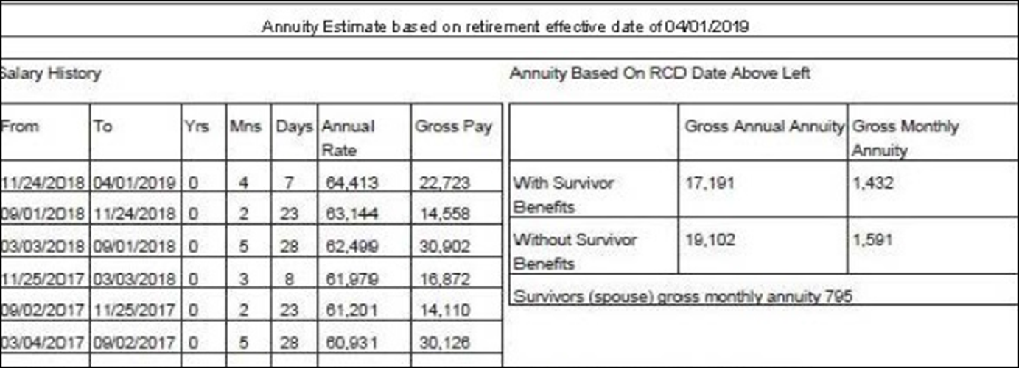
Test Your Understanding: Survivor Annuity
On this FERS Annuity Estimate, what is the amount of Survivor’s gross monthly annuity? $_ _ _
Is the amount of said Survivor’s gross monthly annuity shown a Full Survivor Annuity or a Partial Survivor Annuity? _________
How is the monthly REDUCTION (not shown) for this survivor annuity computed? _ _% of _,_ _ _
How much would the annuitant receive, monthly, if she elected a Full Survivor Annuity for her spouse? $_,_ _ _ per month
Notes:
HANDOUT #12
On this FERS Annuity Estimate, what is the amount of Survivor’s gross monthly annuity? $795
Is the amount of said Survivor’s gross monthly annuity shown a Full Survivor Annuity or a Partial Survivor Annuity? Full, because it’s 50% of the monthly benefit Without Survivor Benefits
How is the monthly REDUCTION (not shown) for this survivor annuity computed? 10% of 1,591 (which = $159, the amount subtracted from $1,591 to equal $1,432)
How much would this annuitant receive, monthly, if she elected a Full Survivor Annuity for her spouse? $1,432 per month, the amount shown as With Survivor Benefits
CSRS-A spousal survivor annuity is 55% of an annuity computed as if the employee had retired on a disability retirement as of the date of death.
A spouse receives 55% of the HIGHER of 1 or 2 below: An annuity computed under the general formula (see Chap 50) based on the deceased employee's Hi-3 avg salary and length of service to DoD, including credit for unused sick leave.
A "guaranteed minimum" which is the LESSER of: 40% of the deceased employee's Hi-3 average salary; or
The regular annuity obtained after increasing the deceased employee's length of service by the period of time between the date of death and the date he or she would have been age 60.
FERS--A spousal survivor annuity is computed as if the employee retired optionally (with no age reduction) on the date of death.
Survivor receives 50% of the employee's basic annuity, based on the deceased employee's type of service, age, length of service, and high-3 average salary at date of death. (See Chapter 50.)
For employees with a CSRS annuity component, the spouse receives 50 percent of the combined CSRS and FERS benefit.

Slide 55
Reduction for Insurable Interest Annuity
“Insurable interest" is an insurance term which applies to someone who would reasonably expect to derive financial benefit from your continued life.
It is presumed to exist if you name as beneficiary of the insurable interest, any of the following individuals:
a spouse;
a blood or adopted relative closer than first cousins;
an ex-spouse;
a person to whom you are engaged to be married; or
a person with whom you are living in a relationship that would constitute a common-law marriage in a jurisdiction that recognizes common-law marriages.

Slide 56
Reduction for Insurable Interest Annuity
If the person named is not one of the above, you should submit affidavits with your retirement application from one or more people with knowledge of the individual's insurable interest. The affidavits should state:
the relationship between you;
the extent to which the person named is dependent on you;
the reasons why the person named might reasonably expect to derive financial benefit from your continued life.

Slide 57
Cost of Reduction for Insurable Interest Annuity
Age of person named in relation to age of retiring employee:
older, same age, or less than 5 years younger 10 %
5 but less than 10 years younger 15%
10 but less than 15 years younger 20%
15 but less than 20 years younger 25%
20 but less than 25 years younger 30%
25 but less than 30 years younger 35%
30 or more years younger 40%

Slide 58
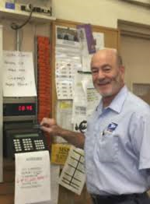
How to retire
Decide what day to retire
Get annuity estimate
Get blue book
Copy blank forms in the blue book
Set up counseling with HRSSC
Ensure deposit is made for military time, if applicable
Complete forms
Send them in

Slide 59
What is the best date to retire?
Once you are eligible to retire, you have the absolute right to decide when to retire. There may be financial considerations:
Entitlement to FERS annuity begins the first day of the month following the month in which you retire. Therefore, many letter carriers decide to retire the last day of a month.
Under CSRS you can retire on one of the first three days of a month and annuity commences the following day.
Annual leave and sick leave are credited each pay period. But AL or SL are not prorated if an employee does not remain employed for an entire pay period. That is why some decide to retire on the last day of a pay period.
Notes:
OPM computes years of service for determining amount of annuity in years and months. Days over a month are dropped. So some LCs decide to retire on a date that results in the total years of service computing to exact years and months, with no (or few) extra days.
Annual leave and sick leave are credited each pay period. But if an employee does not remain employed for an entire pay period, no AL or SL is credited. Neither AL nor SL is prorated for working part of a pay period. So some LCs decide to retire on the last day of a pay period.
The amount of the Special Annuity Supplement is computed based on years of service under FERS (not including military time, prior non-career federal service, saved sick leave, etc.) rounded to the nearest whole number. So some FERS retirees decide to retire on a date that results in years of FERS service being just over 6 months instead of just under six months.

Slide 60
Get annuity estimate
Call USPS Shared Services, give date you want to retire, ask for annuity estimate.
Alternately, go on-line to USPS LiteBlue and enter data for a quicker estimate.
Requests for estimates in no way bind you to retire on any requested date.

Slide 61
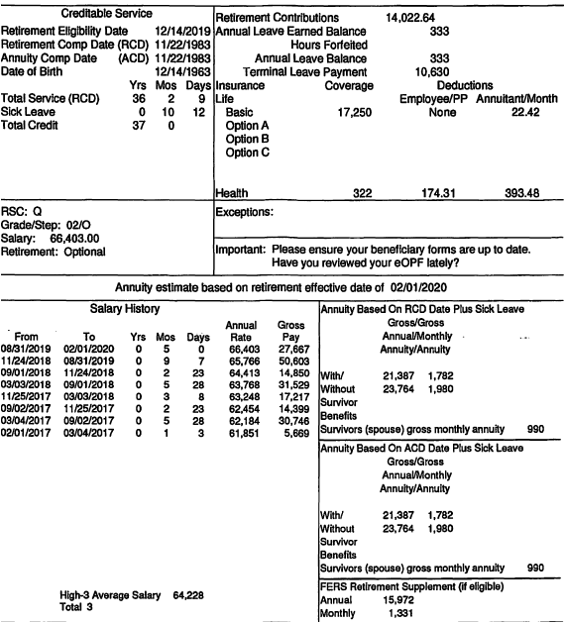
Sample
Annuity
Estimate
Notes:
HANDOUT #13 Sample Annuity Estimate

Slide 62
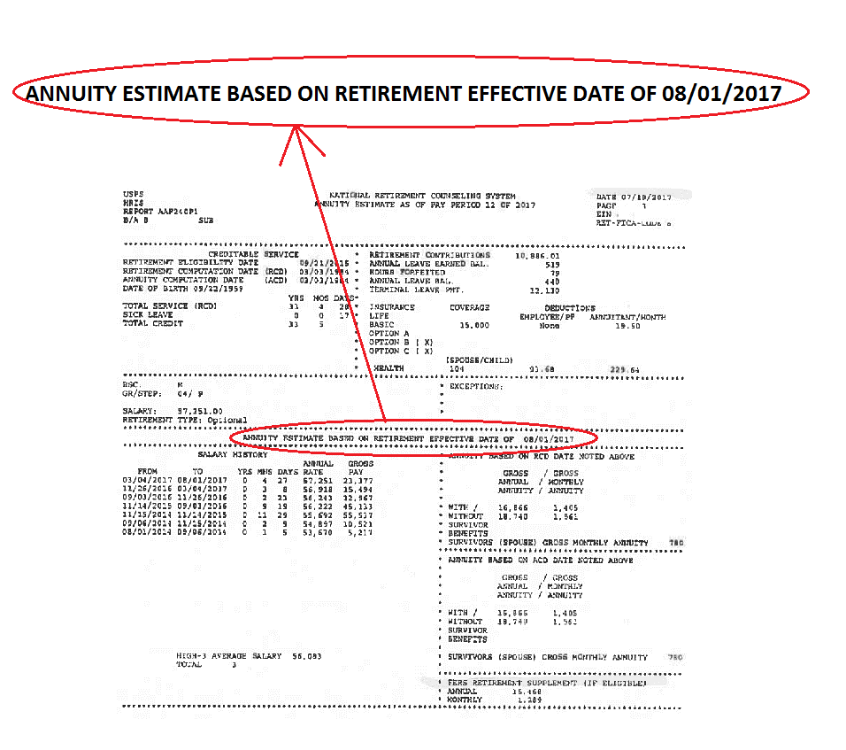
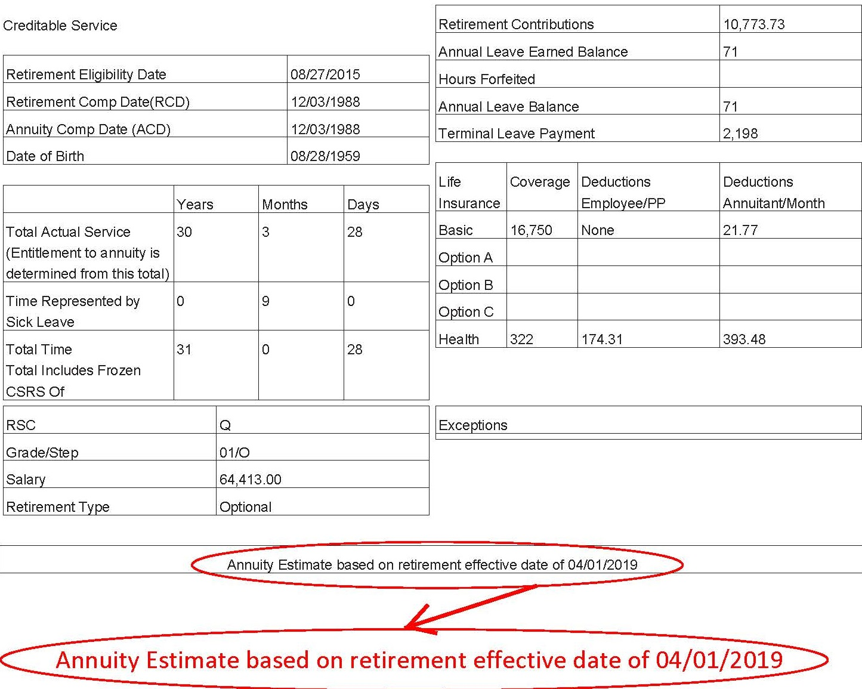

Slide 63
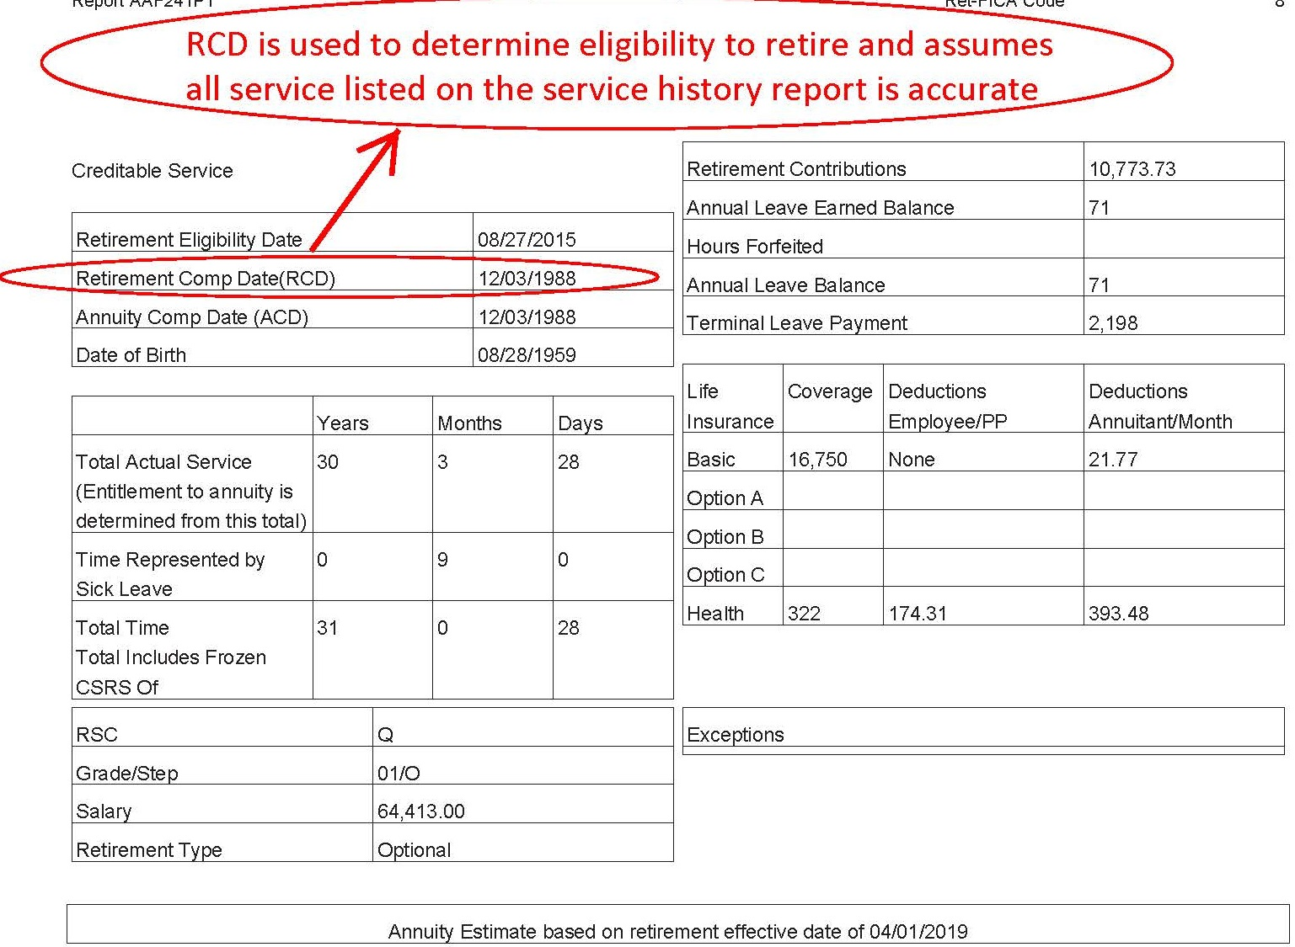

Slide 64
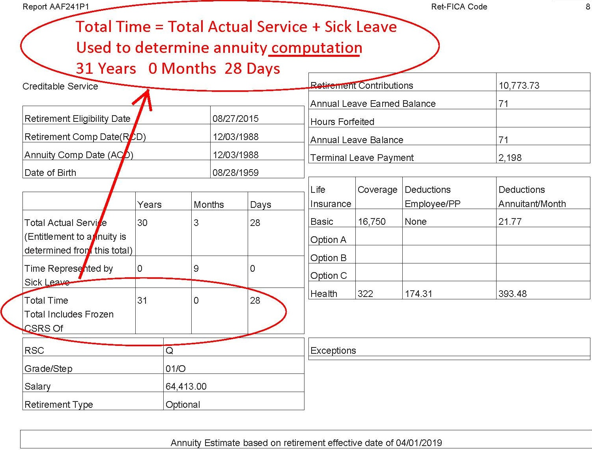

Slide 65
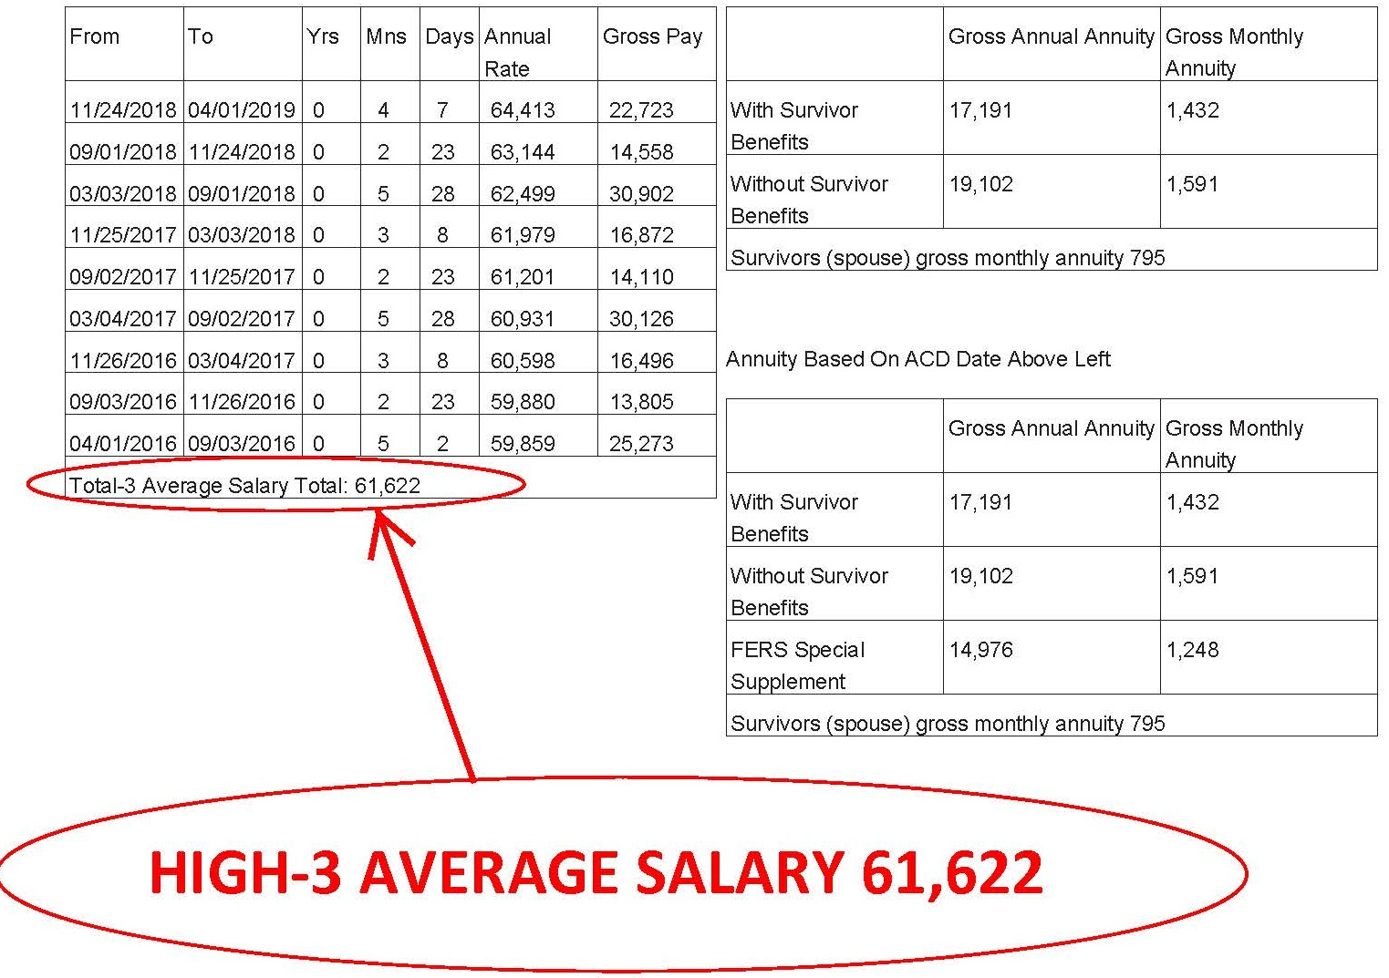

Slide 66
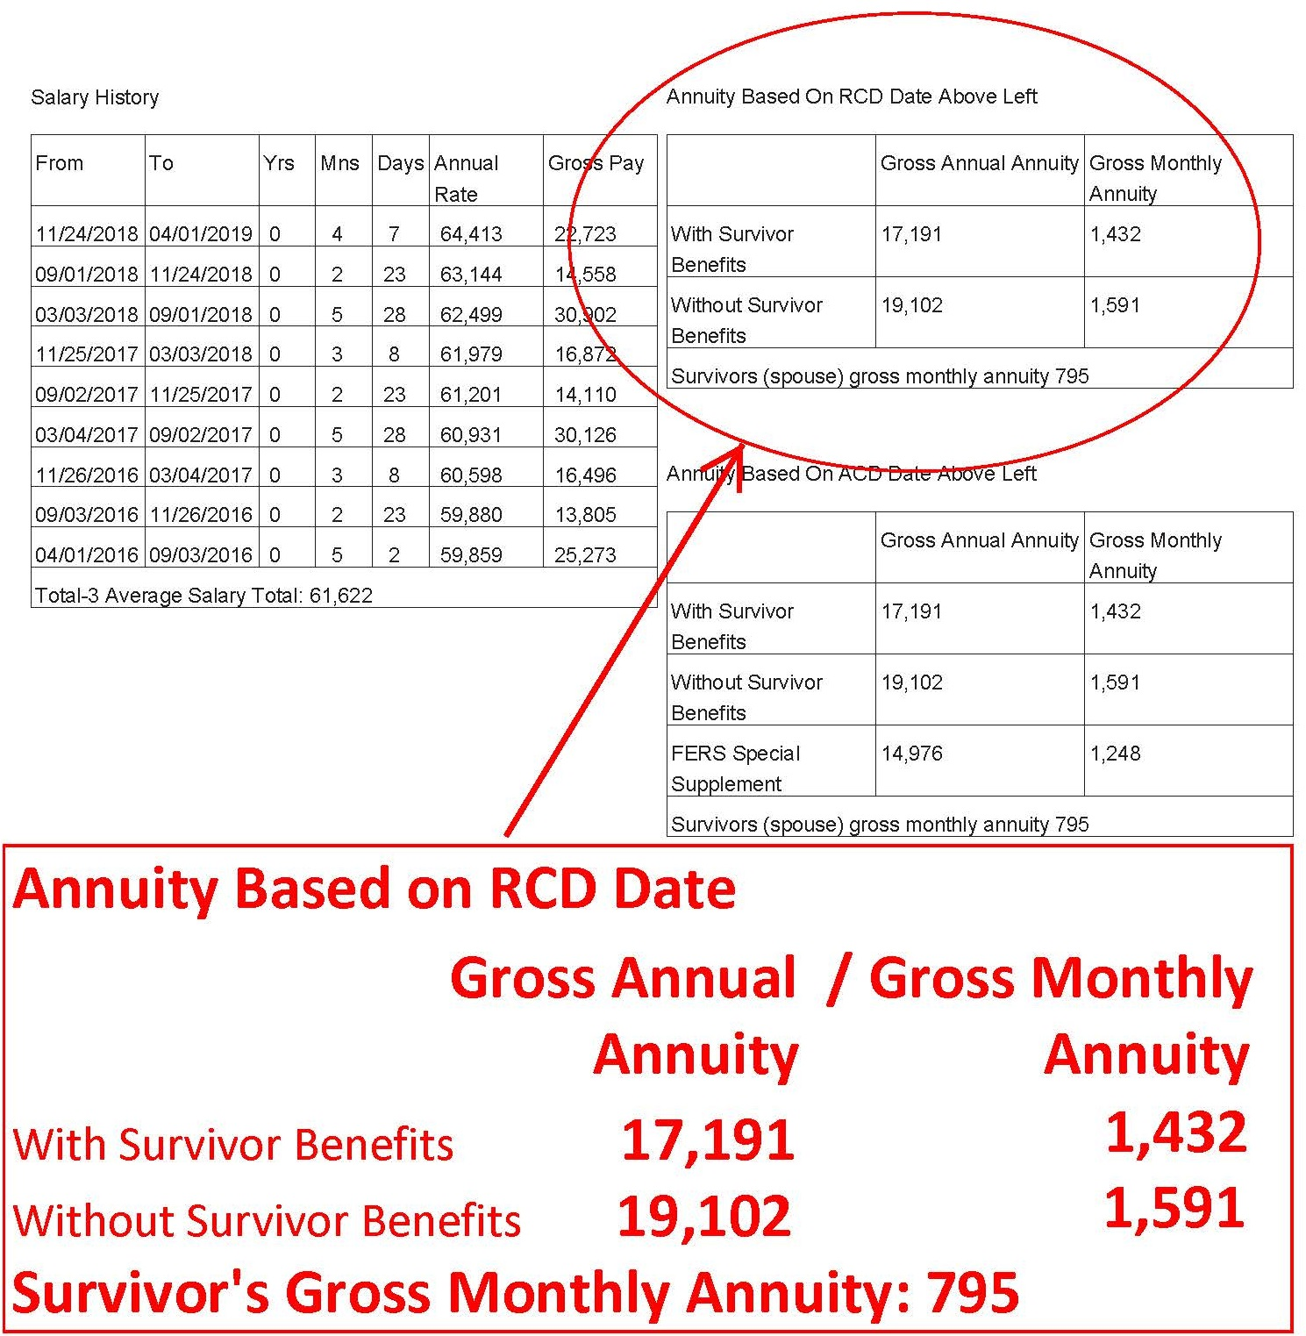

Slide 68
Get blue book
OPM requires that retirement applications of current employees be submitted through the employing agency.
Call USPS Shared Services and ask for a retirement application packet (which USPS sends bound in a blue cover). It includes all of the necessary forms, each pre-printed at the top with your name and Employee Identification Number.
Copy the forms in the Blue Book, so that a blank form is always available. Some of the forms are not valid if erasures, whiteouts or corrections are made.

Slide 70
Set up counseling
Call USPS Shared Services and request a phone counseling session.
You have a right to the counseling session on the clock.
You have a right to have your spouse and/or representative present at the session. (Although if they are also postal employees, they do not have a right to be on the clock.)
You have a right to a private space for the session.
See M-1708

Slide 71
Mr. Fredric V. Rolando
President M-01708
National Association of letter
Carriers, AFl-CIO
100 Indiana Avenue, NW Re: Q01N-4Q-C 07150373
Washington, DC 20001-2144 Class - Article 19
Dear Mr. Rolando:
Our representatives have met on several occasions to discuss the above-referenced case scheduled for
national arbitration.
After reviewing this matter, the parties agree to resolve this matter based on the following:
If an employee who is eligible for and has requested individual retirement counseling wishes to have
this counseling on the clock, local management will arrange reasonably private space for this
purpose and will permit the employee's spouse and or advisor to be with the employee during this
process. If the employee's spouse or advisor is a Postal Service employee only the employee
receiving the requested retirement counseling will be on the clock.
If such an employee is not able to call the Human Resources Shared Services Center to-begin or
complete the individual retirement counseling process without assistance, local management will
offer assistance to facilitate completion of the individual retirement counseling. The District
Manager, Human Resources will be contacted and will determine who will provide such assistance.
Such assistance will include but not be limited to completion of Standard Form 2801 and any other
forms related to life/Health/TSP/ Beneficiary and any Military or civilian service deposit selection
issues. Whether an employee who requests individual retirement counseling is unable to start or
complete the retirement counseling will be determined jointly by management and union at the local
level on a case-by-case fact circumstance basis. This will include employees who have started and
request assistance during the individual retirement counseling process.
Please sign and return the enclosed copy of this decision as acknowledgment of your agreement to resolve
this case.
Sincerely,
Alan S. Moore
Manager, labor Relations
Policy and Programs
…If an employee who is eligible for and has requested retirement counselling wishes to have this counselling on the clock, local management will arrange reasonably private space for this purpose and will permit the employee’s spouse…to be with…
…if such employee is not able to call the HRSSC to begin or complete the individual retirement counselling process without assistance, local management will offer assistance….
Notes:
HANDOUT #14 M-01708 Retirement Counselling

Slide 72
Complete deposit for military time
If applicable
Deposit for military time, unlike deposit for prior non-career federal service, must be completed prior to retirement.

Slide 73
Complete forms
The forms in the Blue Book are preprinted with your name and employee ID number, which will help ensure efficient and problem-free processing.
A special note about SF 2801-1 (CSRS) or SF 3107-1 (FERS): Certified Summary of Federal Service.
USPS sometimes sends a blank form. You have a right to know what USPS is certifying prior to signing.

Slide 74
Send the forms in to HRSSC
USPS’ HRSSC will send the completed forms to its Eagan Finance Center, which will process the forms on to OPM.
OPM will send you a CSA number and begin interim payments, usually without delay.
Interim payments are computed at about 80% of estimated annuity and only federal income taxes are withheld.
Normally, after two or three months of interim payments, OPM will issue a final determination and begin full deductions, and also adjust for the prior interim payments.
Annuity payments are made by OPM the first business day of the month following the month for which the payment is made.

Slide 75
Some things to focus on
before retirement
Flexible Spending Accounts
Uniforms
Copy Official Personnel Folder (OPF)
Make copies of all retirement application forms once they are filled out for your records

Slide 76
Flexible Spending Accounts
If you participate in the FSA, your period of participation ends the day after you retire. You may file a claim for the expenses of services or items that were received prior to the day after your retirement, but any services or items provided after your retirement date are not eligible for payment.
Claims for reimbursement of services or items received while still employed may be made until September 30 of the following year.
If you used your entire elected amount before it has been deducted from your pay, you will not be responsible for the remaining allotments.

Slide 77
Uniforms
ELM 936.2
Payment for Uniform Purchase After Separation of Employee
Payment to the vendor is not allowed if the following conditions exist:
a. The employee separates from the uniform program for any reason, including retirement, within 30 days following purchase of items of uniform wear that are not recognizable as distinctive uniform items unless worn with the basic outer garments of the uniform. In these cases notify both employee and specific vendor involved. Return the invoice to the vendor (see 936.32). Nondistinctive items include shoes, gloves, rubbers, galoshes, overboots, hose, face masks, pith helmets, and belts.
b. When there is evidence that, before making the purchase, the employee indicated an intention to separate from the uniform program for any reason, including retirement, involuntary separation, or bid to an assignment not requiring the same uniform category, do not process the invoice for payment. After placing a copy of the invoice in the employee’s uniform file with the appropriate remarks, return the invoice to the vendor advising why it will not be honored.

Slide 78
Official Personnel Folder (OPF)
OPFs contain important documents such as:
Health Benefits Program Registration
FEGLI Enrollment forms
Designations of Beneficiary
Form 50 history
Active employees have on-line access to their OPF through USPS LiteBlue.
Retirees do not have access to LiteBlue.
Most retirees will never have a significant need to access proof of past HBP registration, FEGLI designation of beneficiary, Form 50 pay history, etc. However, sometimes problems arise with retirement that can be resolved easily if the retiree has these documents.

Slide 79
Official Personnel Folder (OPF)
Before you retire:
Go on-line to Lite-Blue. Find your OPF. Copy it to paper or electronically. Save it.
USPS will delete your access to Lite-Blue the day after you retire, and will send those OPF documents to the Federal Records Center. You will not be able to easily obtain these documents from USPS after you retire.
If you ever do need a document* to solve a problem or issue, you can simply retrieve it from your stored file.
*E.g., Health Benefits registration, FEGLI coverage, designation of beneficiary, debt collection related documents, etc.

Slide 80
Some things to know about
after retirement
Terminal Leave Payments (saved annual leave)
Direct Deposit of Annuity Required
Post Retirement Debt Collection
OPM Services On-line
Cost of Living Adjustments
Federal Income Tax on Annuity
Understanding OPM’s Notice of Annuity Adjustment
Maintain NALC Membership

Slide 81
Saved Annual Leave Upon Retirement
(Terminal Leave Payments)
Lump sum terminal leave payment includes:
accumulated AL up to maximum carryover (440 hours), plus
any unused donated leave, plus
holidays that fall within the terminal leave period (for Full-Time Regulars and Part-Time Regulars)
Any part of the unused annual leave earned during the leave year of separation that is in excess of the maximum carryover amount is granted prior to separation rather than paid out in the form of a lump sum payment.
ELM 512.732b
Unused donated leave is included in the terminal leave payment irrespective of the maximum carryover; and all earned leave is included, if retiring under an early out (VER).
Notes:
http://apps.opm.gov/Listserv_Apps/list-sub.cfm

Slide 82
Direct Deposit Required
OPM requires direct deposit of monthly annuity.
Deposit can be to an account at a financial institution such as a credit union or bank;
Or deposit can be to a Direct Express Card.
The card can be used to make purchases at stores that accept Debit MasterCard, pay bills, purchase money order at the Post Office, and get cash from an ATM or financial institution that accepts MasterCard. There are no fees for the deposit into the card each month, and no charge for using the card to make purchases.
Go to www.GoDirect.org for information about fees and the surcharge-free network.

Slide 83
Post-Retirement Debt Collection
If you receive notice from USPS after retirement that you owe money to USPS, immediately contact your branch and your NBA office. The Debt Collection Act requires USPS to provide appeal rights. There is a 30 day time limit to appeal. A timely appeal will stop all collection efforts.
You can also file a grievance challenging a post-retirement debt collection notice, even though you are retired. This is a new right first negotiated in the 2016 – 2019 National Agreement.
If you do not timely appeal, USPS will advise the U.S. Treasury, which can then deduct the claimed debt from your retirement, income tax, social security, etc., without any appeal rights. Treasury can also add interest and penalties.
Notes:
http://apps.opm.gov/Listserv_Apps/list-sub.cfm

Slide 84
Post-Retirement Debt Collection
If you receive a debt collection letter from USPS after you retire, seek assistance from your branch, your NBA, or HQ.
Do not fail to initiate a timely appeal
Notes:
http://apps.opm.gov/Listserv_Apps/list-sub.cfm

Slide 85
Sign up for OPM MyRetirement
Services Online
https://www.servicesonline.opm.gov/
You need your CSA number in order to sign up, so you cannot sign up until you receive that number from OPM.

Slide 86
OPM Services Online
View/Print 1099-R Tax Forms
Change Federal and State Income Tax Withholding
View/Print Annuity Statement/Verification of Income
View/Print a Year-to-Date Summary Of Payments
View/Print Verification of Life Insurance (FEGLI)
Change Mailing Address
Change SOL Password
View the Status of Case while in Interim Pay
Establish an Allotment to an Organization
Request Duplicate Annuity Booklet
Set up a Checking or Savings Allotment
Sign up for Direct Deposit of Annuity Payment
Update Email Address/Opt-in to Receive Information Electronically
View/Print Retirement Services Reference Card (ID Card)

Slide 87
Cost of Living Adjustments (COLAS)
CSRS
FERS
Begins the first December after retirement
First COLA is prorated
Generally not applied until the December after age 62
Exception: Disability
Notes:
COLAs are not automatic. There was no COLA payable for retirees in 2010 & 2011
Consumer Price Index (CPI) for urban wage earners and clerical workers from the third quarter average of the previous year to the third quarter average for the current year.
COLA for 2013?
OPM website has the list of all COLAs at: http://www.opm.gov/retire/annuity/cola/colalist.asp

Slide 88
Cost of Living Adjustments (COLAS)
FERS
CSRS
Equals the percent change in the Consumer Price Index (CPI)
If the percent change in the CPI is:
0-2% the COLA equals the CPI increase
2-3% the COLA equals 2%
Over 3% the COLA equals the change in the CPI minus 1%
Notes:
Rounded down to the next whole dollar.
2% or less---2%
>2% but < 3%---2%
> 3%---3% minus 1

Slide 89
Federal Income Tax
Your CSRS or FERS annuity is subject to federal income tax. The total amount you contributed into the Civil Service Retirement and Disability Trust Fund over your working career, however, is tax sheltered, since that amount has already been subject to federal income tax.
Notes:
OPM uses the IRS “Simplified Method” to determine the small monthly amount of your annuity that is not taxed.
See IRS Publication 721.
E.g., if elected survivor annuity: Add retiree and spouse ages at start of retirement. Find factor in chart. Divide the total dollar amount of your retirement contributions into this factor. That is the monthly amount of annuity sheltered from federal income tax.
IRS Simplified Method
Combine annuitant and spouses age based on date on annuity starting date
Combined age The factor is
110 or under 410
111-120 360
121-130 310
131-140 260
141 or over 210

Slide 90
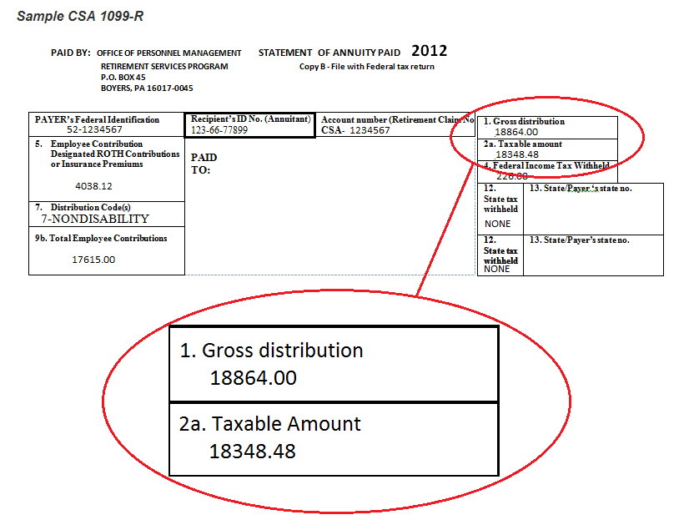

Slide 91
Notice of Annuity Adjustment
Pensions are deposited monthly, on the first business day of each month. OPM only mails an explanation of benefits when there is an adjustment to an annuity (e.g., COLA increase, change in Health Benefit premiums or Life Insurance premiums, etc.)
When OPM sends a Notice of Annuity Adjustment, it will show 1) gross, 2) deductions, and 3) net. But the gross will be the amount after reduction for survivor annuity.
OPM does not list the cost of the reduction for survivor annuity as a deduction. Instead, OPM lists the gross annuity as the amount after reduction for survivor annuity.

Slide 92
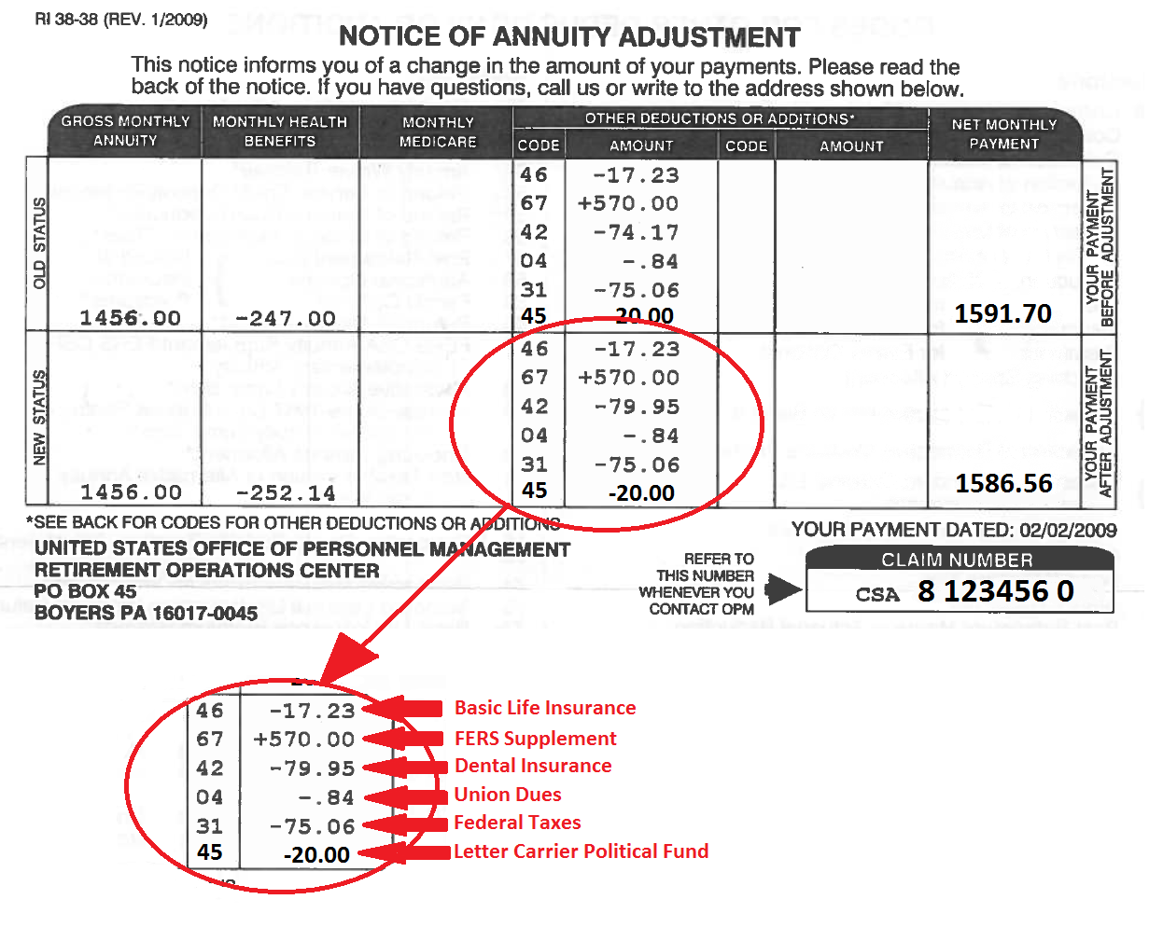
Notes:
HANDOUT #15
http://apps.opm.gov/Listserv_Apps/list-sub.cfm

Slide 93
Maintain NALC Membership
National Constitution
Article 2 Section 1(a):
Membership in the NALC shall be… retirees… who were regular members of the NALC when they retired…
Article 2 Section 1(e):
A Form 1189 (Dues Check-off Provision) must be signed by all retiring members within the NALC who wish to retain their membership… effective October 1, 1982.
Notes:
http://apps.opm.gov/Listserv_Apps/list-sub.cfm

Slide 94
1189 must include CSA number!
Notes:
http://apps.opm.gov/Listserv_Apps/list-sub.cfm

Slide 95
National Retiree Dues
National Constitution Article 7(b):
A member who has retired from the Postal Service under the CSRS or FERS shall pay to the National Association $7 per annum…
Notes:
http://apps.opm.gov/Listserv_Apps/list-sub.cfm

Slide 96
Annual State Retiree Dues
Alabama $4.00
Alaska 0
Arizona 0
Arkansas 0
California $0.50
Colorado 0
Connecticut 0
Delaware 0
DC $5.00
Florida $5.10
Georgia $2.50
Guam 0
Hawaii 0
Idaho 0
Illinois 0
Indiana 0
Iowa 0
Kansas $7.85
Kentucky 0
Louisiana 0
Maine 0
Maryland $5.00
Massachusetts $1.25
Michigan 0
Minnesota 0
Mississippi 0
Missouri 0
Notes:
http://apps.opm.gov/Listserv_Apps/list-sub.cfm

Slide 97
Annual State Retiree Dues
Montana 0
Nebraska $4.80
Nevada 0
New Hampshire 0
New Jersey $1.00
New Mexico 0
New York $3.60
North Carolina $2.00
North Dakota $5.00
Ohio $1.20
Oklahoma $3.60
Oregon $2.40
Pennsylvania $0.50
Puerto Rico $3.60
Rhode Island $0
South Carolina $1.00
South Dakota 0
Tennessee $2.00
Texas 0
Utah $1.20
Vermont 0
Virginia $6.00
Virgin Island 0
Washington $7.20
West Virginia $24.00
Wisconsin $1.20
Wyoming 0
Notes:
http://apps.opm.gov/Listserv_Apps/list-sub.cfm

Slide 98
Important Phone Numbers
USPS Shared Services: 877-477-3273 (option 5)
NBA: (name) (phone number)
NALC Retirement Dept: 202-393-4695
Toll free MWTh 10-12 & 2-4: 800-424-5186
Notes:
http://apps.opm.gov/Listserv_Apps/list-sub.cfm

Slide 99
More Information
Sign up to receive the Benefits Info listserv emails!
Log into the OPM webpage at:
http://apps.opm.gov/Listserv_Apps/list-sub.cfm
Notes:
http://apps.opm.gov/Listserv_Apps/list-sub.cfm

Slide 100
The War on Retirement
Legislative Attacks
Notes:
HANDOUT #16 WEP/GPO FACT SHEET

Slide 101
Civil Service Retirement System (CSRS)
What CSRS employees pay
Most employees pay: 7% 12% plus
Employing agency pays: 7% 2%
House continuing resolution passed 3/29/12
Notes:
HANDOUT #16 WEP-GPO fact sheet
CSRS-The Civil Service Retirement Act, which became effective on August 1, 1920, established a retirement system for certain Federal employees. The Civil Service Retirement System (CSRS) is a defined benefit, contributory retirement system. Employees share in the expense of the annuities to which they become entitled. CSRS covered employees contribute 7, 7 1/2 or 8 percent of pay to CSRS and, while they generally pay no Social Security retirement, survivor and disability (OASDI) tax, they must pay the Medicare tax (currently 1.45 percent of pay). The employing agency matches the employee's CSRS contributions.
CSRS employees may increase their earned annuity by contributing up to 10 percent of the basic pay for their creditable service to a voluntary contribution account. See Chap 31 & SF2804.
Employees may also contribute a portion of pay to the Thrift Savings Plan (TSP). There is no Government contribution, but the employee contributions are tax-deferred. For more information about TSP, see the TSP website.

Slide 102
Federal Employees Retirement System (FERS)
What FERS employees pay
Most employees pay 0.8% into Basic Benefit Plan
3.1% for those hired > 1/1/13* FERS-RAE
4.4% for those hired > 1/1/14** FERS-FRAE
7.5% for those hired > 1/1/18*** phased in 1%/year
Plus 6.2% into Social Security
*Middle Class Tax Relief and Job Creation Act of 2012 Passed into law
** Bipartisan Budget Act of 2013 Passed into law
*** President Trump 2018 proposed budget
Notes:
FERS-Congress created the Federal Employees Retirement System (FERS) in 1986, and it became effective on January 1, 1987. Since that time, new Federal civilian employees who have retirement coverage are covered by FERS.
FERS is a retirement plan that provides benefits from three different sources: a Basic Benefit Plan, Social Security, and the Thrift Savings Plan (TSP). Two of the three parts of FERS (Social Security and the TSP) can go with you to your next job if you leave the Federal Government before retirement. The Basic Benefit and Social Security parts of FERS require you to pay your share each pay period. Your agency withholds the cost of the Basic Benefit and Social Security from your pay as payroll deductions. Your agency pays its part too. Then, after you retire, you receive annuity payments each month for the rest of your life.
The TSP part of FERS is an account that your agency automatically sets up for you. Each pay period your agency deposits into your account amount equal to 1% of the basic pay you earn for the pay period. You can also make your own contributions to your TSP account and your agency will also make a matching contribution. These contributions are tax-deferred. The Thrift Savings Plan is administered by the Federal Retirement Thrift Investment Board.

Slide 103
Federal Employees Retirement System (FERS)
FERS effective 1/1/1987
3 different components:
Basic Benefit Plan (+ Special Annuity Supplement)
Social Security
Thrift Savings Plan (up to 5% matching)
House continuing resolution passed 3/29/12
HR 3813
Obama Administration FY 2013 budget
President Trump 2018 proposed budget
Notes:
FERS-Congress created the Federal Employees Retirement System (FERS) in 1986, and it became effective on January 1, 1987. Since that time, new Federal civilian employees who have retirement coverage are covered by FERS.
FERS is a retirement plan that provides benefits from three different sources: a Basic Benefit Plan, Social Security, and the Thrift Savings Plan (TSP). Two of the three parts of FERS (Social Security and the TSP) can go with you to your next job if you leave the Federal Government before retirement. The Basic Benefit and Social Security parts of FERS require you to pay your share each pay period. Your agency withholds the cost of the Basic Benefit and Social Security from your pay as payroll deductions. Your agency pays its part too. Then, after you retire, you receive annuity payments each month for the rest of your life.
The TSP part of FERS is an account that your agency automatically sets up for you. Each pay period your agency deposits into your account amount equal to 1% of the basic pay you earn for the pay period. You can also make your own contributions to your TSP account and your agency will also make a matching contribution. These contributions are tax-deferred. The Thrift Savings Plan is administered by the Federal Retirement Thrift Investment Board.

Slide 104
Federal Employees Retirement System (FERS)
FERS effective 1/1/1987
3 different components:
Basic Benefit Plan (+ Special Annuity Supplement)
Social Security (Reduced via Chained CPI)
Thrift Savings Plan (up to 5% matching)
Obama Administration 2012 and 2013 budgets
House Budget Bill passed November 2017
Notes:
FERS-Congress created the Federal Employees Retirement System (FERS) in 1986, and it became effective on January 1, 1987. Since that time, new Federal civilian employees who have retirement coverage are covered by FERS.
FERS is a retirement plan that provides benefits from three different sources: a Basic Benefit Plan, Social Security, and the Thrift Savings Plan (TSP). Two of the three parts of FERS (Social Security and the TSP) can go with you to your next job if you leave the Federal Government before retirement. The Basic Benefit and Social Security parts of FERS require you to pay your share each pay period. Your agency withholds the cost of the Basic Benefit and Social Security from your pay as payroll deductions. Your agency pays its part too. Then, after you retire, you receive annuity payments each month for the rest of your life.
The TSP part of FERS is an account that your agency automatically sets up for you. Each pay period your agency deposits into your account amount equal to 1% of the basic pay you earn for the pay period. You can also make your own contributions to your TSP account and your agency will also make a matching contribution. These contributions are tax-deferred. The Thrift Savings Plan is administered by the Federal Retirement Thrift Investment Board.

Slide 105
Federal Employees Retirement System (FERS)
FERS effective 1/1/1987
3 different components:
Basic Benefit Plan (+ Special Annuity Supplement)
Social Security
Thrift Savings Plan (up to 5% matching) *
Return on G-fund reduced to 0.02%**
*S-1486 – Would allow USPS to bargain with unions to eliminate USPS matching TSP contributions
** House Budgets 2016 & 2017; 2015 Highway Transportation bill
Notes:
FERS-Congress created the Federal Employees Retirement System (FERS) in 1986, and it became effective on January 1, 1987. Since that time, new Federal civilian employees who have retirement coverage are covered by FERS.
FERS is a retirement plan that provides benefits from three different sources: a Basic Benefit Plan, Social Security, and the Thrift Savings Plan (TSP). Two of the three parts of FERS (Social Security and the TSP) can go with you to your next job if you leave the Federal Government before retirement. The Basic Benefit and Social Security parts of FERS require you to pay your share each pay period. Your agency withholds the cost of the Basic Benefit and Social Security from your pay as payroll deductions. Your agency pays its part too. Then, after you retire, you receive annuity payments each month for the rest of your life.
The TSP part of FERS is an account that your agency automatically sets up for you. Each pay period your agency deposits into your account amount equal to 1% of the basic pay you earn for the pay period. You can also make your own contributions to your TSP account and your agency will also make a matching contribution. These contributions are tax-deferred. The Thrift Savings Plan is administered by the Federal Retirement Thrift Investment Board.

Slide 106
Federal Employees Retirement System (FERS)
FERS effective 1/1/1987
3 different components:
Basic Benefit Plan (+ Special Annuity Supplement)
Social Security
Thrift Savings Plan (up to 5% matching)
Burr, Coburn Chambliss senate bill: Public-Private Employee Retirement Parity Act introduced 11/12/2013 S 644
Notes:
FERS-Congress created the Federal Employees Retirement System (FERS) in 1986, and it became effective on January 1, 1987. Since that time, new Federal civilian employees who have retirement coverage are covered by FERS.
FERS is a retirement plan that provides benefits from three different sources: a Basic Benefit Plan, Social Security, and the Thrift Savings Plan (TSP). Two of the three parts of FERS (Social Security and the TSP) can go with you to your next job if you leave the Federal Government before retirement. The Basic Benefit and Social Security parts of FERS require you to pay your share each pay period. Your agency withholds the cost of the Basic Benefit and Social Security from your pay as payroll deductions. Your agency pays its part too. Then, after you retire, you receive annuity payments each month for the rest of your life.
The TSP part of FERS is an account that your agency automatically sets up for you. Each pay period your agency deposits into your account amount equal to 1% of the basic pay you earn for the pay period. You can also make your own contributions to your TSP account and your agency will also make a matching contribution. These contributions are tax-deferred. The Thrift Savings Plan is administered by the Federal Retirement Thrift Investment Board.

Slide 107
Federal Employees Retirement System (FERS)
FERS effective 1/1/1987
3 different components:
Basic Benefit Plan (+ Special Annuity Supplement)
Social Security (Reduced via Chained CPI)
Thrift Savings Plan (up to 5% matching)
No matching employer contribution
G fund return reduced to 0.02%
Notes:
FERS-Congress created the Federal Employees Retirement System (FERS) in 1986, and it became effective on January 1, 1987. Since that time, new Federal civilian employees who have retirement coverage are covered by FERS.
FERS is a retirement plan that provides benefits from three different sources: a Basic Benefit Plan, Social Security, and the Thrift Savings Plan (TSP). Two of the three parts of FERS (Social Security and the TSP) can go with you to your next job if you leave the Federal Government before retirement. The Basic Benefit and Social Security parts of FERS require you to pay your share each pay period. Your agency withholds the cost of the Basic Benefit and Social Security from your pay as payroll deductions. Your agency pays its part too. Then, after you retire, you receive annuity payments each month for the rest of your life.
The TSP part of FERS is an account that your agency automatically sets up for you. Each pay period your agency deposits into your account amount equal to 1% of the basic pay you earn for the pay period. You can also make your own contributions to your TSP account and your agency will also make a matching contribution. These contributions are tax-deferred. The Thrift Savings Plan is administered by the Federal Retirement Thrift Investment Board.

Slide 108
CSRS & FERS Basic Annuity
Annuity is based on a percentage of the High 3 5 year average salary
Percentage is determined by the amount of creditable service and the appropriate annuity formula
Securing Annuities for Federal Employees Act 2012
President Trump 2018 proposed budget

Slide 109
CSRS & FERS COLAs
CSRS – COLA percentage decreased by ½ of 1% e.g., if COLA is 2.6%, only 2.1% paid
FERS – Zero COLA
President Trump 2018 proposed budget

Slide 110
2018 Trump Budget
FERS employee contributions increase 1% each year until equal to the governments contribution. This would take five to six years and increase employee contributions by up to 775% with no increase in benefits
Change from the High-3 Average Salary to a High-5 Average Salary
Eliminate Cost of Living Adjustments (COLA) for current and future FERS employees
Decrease the COLA for CSRS employees by 0.5% from the current formula
Eliminate the Special Annuity Supplement for FERS employees that helps bridge the gap until age 62
Reduce the TSP’s G-Fund interest rate

Slide 111
Active & Retired Letter Carriers: Fight Back!
Vote
Contribute to Letter Carrier Political Fund
By making a contribution to the Letter Carrier Political Fund, you are doing so voluntarily with the understanding that your contribution is not a condition of membership in the National Association of Letter Carriers or of employment by the Postal Service, nor is it part of union dues. You have a right to refuse to contribute without any reprisal. The Letter Carrier Political Fund will use the money it receives to contribute to candidates for federal office and undertake other political spending as permitted by law. Your selection shall remain in full force and effect until cancelled. Contributions to the Letter Carrier Political Fund are not deductible for federal income tax purposes. Federal law prohibits the Letter Carrier Political Fund from soliciting contributions from individuals who are not NALC members, executive and administrative staff or their families. Any contribution received from such an individual will be refunded to that contributor. Federal law requires us to use our best efforts to collect and report the name, mailing address, occupation and name of employer of individuals whose contributions exceed $200 per calendar year. Any guideline amount is merely a suggestion, and an individual is free to contribute more or less than the guideline suggests and the Union will not favor or disadvantage anyone by reason of the amount of their contribution or their decision not to contribute.
…with the understanding that your contribution is not a condition of union membership…nor is it part of union dues….The Letter Carrier Political Fund will use the money it receives to contribute to candidates for federal office and undertake other political spending….Contributions to the LCPF are not deductible for federal income tax purposes….

Slide 113
Post-Retirement FEHB
Federal Employees Health Benefits

Slide 114
FEHB Information for Retirees
https://www.opm.gov/healthcare-insurance/healthcare/eligibility/information-for-retirees-and-survivor-annuitants.pdf

Slide 115
FEHB Eligibility when Retiring
In order to carry your FEHB coverage into retirement, you must be entitled to retire on an immediate annuity (including the Federal Employees Retirement System (FERS) Minimum Retirement Age (MRA) + 10 retirement); and
-you must have been continuously enrolled (or covered as a family member) in any FEHB plan(s) for the 5 years of service immediately before the date your annuity starts, (a.k.a. the 5 year rule) or first opportunity to enroll if less than 5 years.
The 5 year requirement period can include the following:
-the time you are covered as a family member under another person's FEHB enrollment; or
-the time you are covered under the Uniformed Services Health Benefits Program (also known as TRICARE) as long as you were covered under an FEHB enrollment at the time of your retirement.
NOTE: A SURVIVING SPOUSE CAN CONTINUE FEHB COVERAGE AFTER AN ANNUITANT’S DEATH ONLY IF A SURVIVOR ELECTION WAS MADE AND THE SPOUSE WAS ACTIVELY COVERED AT THE TIME OF DEATH.

Slide 116
FEHB Eligibility Deferred Annuitants
You may have coverage under the program as a family member based on your spouse’s enrollment, but not based on your deferred annuity.

Slide 117
FEHB Eligibility FERS Postponed Retirement
If you separated from Federal service before you could retire you are not eligible to enroll in the FEHBP when you start to receive your deferred annuity.
Only under FERS, if you are eligible for an immediate retirement at separation, you are eligible to reenroll for health benefits and life insurance coverage when you begin to receive your postponed annuity, if you were eligible to continue the coverage in retirement.

Slide 118
• Most letter carriers maintain FEHB coverage in retirement because USPS continues to pay a large share of the premiums (about 72%). *
• Retirees pay the same FEHB premiums as non-postal federal employees, and have the same open season opportunities as active employees.
*This PS obligation is the basis of the annual $5.8 billion pre-funding problem.

Slide 119
• Generally, decisions to drop FEHB coverage are irrevocable.*
• If you cancel your FEHB to be covered as a family member under another person’s FEHB enrollment, you are eligible to reenroll if you lose coverage under the other person’s enrollment. To reenroll, you must contact OPM within the period beginning 31 days before and ending 60 days after your loss of other FEHB coverage.
*Certain circumstances permit suspension (as opposed to termination) of FEHB enrollment: enrolling in Medicare Advantage, TRICARE, CHAMPVA, or Medicaid.

Slide 120
Post-Retirement FEGLI
Federal Employees Group Life Insurance

Slide 121
FEGLI Handbook
https://www.opm.gov/healthcare-insurance/life-insurance/reference-materials/handbook.pdf
FEGLI is term life insurance. It does not build any cash value. There are no regularly scheduled open seasons to elect or increase FEGLI coverage. OPM schedules open seasons intermittently and rarely.
OPM last scheduled an open season for September 1, 2016 through September 30, 2016.

Slide 122
In order to carry any FEGLI coverage into retirement, you must have been covered for the five years prior to retirement.
Annuitants can reduce or cancel FEGLI coverage at any time.
If annuitant elects to reduce or cancel any part of FEGLI coverage, the election is irrevocable.
Annuitants cannot increase coverage, even during open season.

Slide 123
Basic - Final salary rounded up to nearest 1,000 plus $2,000
Option A - Straight $10,000
Option B - Final salary rounded up to nearest 1,000 times up to 5 multiples
Option C - Family: $5,000 spouse and $2,500 eligible children times up to 5 multiples
Notes:
http://apps.opm.gov/Listserv_Apps/list-sub.cfm

Slide 124
Basic – Final salary rounded up to nearest 1,000 plus $2000
Three choices at retirement:
75% Reduction – payout reduces 2% per month starting at age 65 (or at retirement if > 65) until it reaches 25%, then frozen. No additional premiums after age 65
50% Reduction – payout reduces 1% per month starting at age 65 (or at retirement if >65) until it reaches 50%, then frozen. Premiums increase with age for life (unless annuitant switches to 75% reduction)
No Reduction – payout remains at final salary rounded up to nearest 1,000 plus $2,000. Premiums increase with age for life unless annuitant switches to 75% reduction)
Notes:
http://apps.opm.gov/Listserv_Apps/list-sub.cfm

Slide 125
Option A - Straight $10,000
The amount of Option A coverage automatically begins reducing at age 65 (or retirement, if later).
There is no election other than whether to keep it. If yes, you pay premiums until age 65.
At age 65 you stop paying premiums. The amount of coverage reduces by 2% ($200) each month until the amount has been reduced by 75%. Only 25% of the original amount ($2,500) is payable as a death benefit once the full reduction has been reached.
Notes:
http://apps.opm.gov/Listserv_Apps/list-sub.cfm

Slide 126
Option B – Final salary rounded to next 1,000 up to 5 multiples
At retirement, elect how many of your multiples you want to continue, and choose “no reduction” or “full reduction” (50% is not an option) at age 65 (or retire, if later). You may split elections among your multiples.
If “full reduction” is elected, the original value reduces by 2% each month for 50 months, at which time no benefits are payable. No additional premiums after age 65.
If “no reduction” is elected, there is no reduction in coverage, but you will continue to pay premiums associated with your age group.
Notes:
http://apps.opm.gov/Listserv_Apps/list-sub.cfm

Slide 127
Option C – Family: $5,000 spouse and $2,500 eligible children times up to 5 multiples
At retirement, elect how many of your multiples you want to continue, and choose “no reduction” or “full reduction” at age 65 (or retire, if later).
If “full reduction” is elected, the value reduces 2% of the original amount each month for 50 months, at which time no benefits are payable. No additional premiums after age 65.
If “no reduction” is elected, there is no reduction in coverage, but you will continue to pay premiums appropriate to your age group.
Notes:
http://apps.opm.gov/Listserv_Apps/list-sub.cfm

Slide 128
Monthly cost for continuing Basic FEGLI
Per $1000 of coverage
Age 75% Reduction 50% Reduction No Reduction
Up to 65 $0.3250 $1.0350 $2.4550
After 65 Free $0.71 $2.13
Notes:
https://www.opm.gov/healthcare-insurance/life-insurance/program-information/#url=basic

Slide 129
Monthly cost for continuing
Option A Standard FEGLI
Age: <35 35 – 39 40 – 44 45 – 49 50 – 54 55- 59 60 – 64 65+
Rate: $0.43 $0.65 $0.87 $1.52 $2.38 $4.33 $13.00 Free
Notes:
https://www.opm.gov/healthcare-insurance/life-insurance/program-information/#url=basic

Slide 130
Monthly cost for continuing Option B Additional FEGLI
Per $1000 of coverage
Age <35 35–39 40–44 45–49 50–54 55–59 60–64
Rate $0.043 $0.065 $0.087 $0.152 $0.238 $0.433 $0.953
If full reduction is elected, the cost is free from age 65 and after.
If no reduction is elected, the cost continues to increase with age:
Age 65–69 70–74 75–79 80 and over
Rate $1.17 $2.08 $3.90 $5.72
Notes:
https://www.opm.gov/healthcare-insurance/life-insurance/program-information/#url=basic

Slide 131
Monthly cost for continuing Option C Family FEGLI, per multiple
1 multiple = $5,000 for a spouse
1 multiple = $2,500 for each eligible dependent child
Age <35 35 – 39 40 – 44 45 – 49 50 – 54 55 – 59 60 – 64
Rate $0.48 $0.59 $0.89 $1.28 $1.99 $3.21 $5.85
If full reduction is elected, the cost is free after age 65.
If no reduction is elected, the cost continues to increase with age:
Age 65 – 69 70 – 74 75 – 79 80 and over
Rate $6.80 $8.30 $11.40 $15.60
Notes:
https://www.opm.gov/healthcare-insurance/life-insurance/program-information/#url=basic

Slide 132
Questions about FEGLI?

Slide 133
Thrift Savings Plan
The Thrift Savings Plan is administered by the Federal Retirement Thrift Investment Board (FRTIB). The Board is required by law to manage the TSP solely in the interest of TSP participants and their beneficiaries.
An Employee Thrift Advisory Council (ETAC) provides advice to the Board on investment policies and administration of the TSP. The NALC Chief of Staff to President Rolando, Jim Sauber, serves on the ETAC as vice chairman.
Notes:
http://apps.opm.gov/Listserv_Apps/list-sub.cfm

Slide 134
TSP Modernization Act of 2017,
In Effect Since 9/15/2019
adds flexible withdrawal options and more choices
This means you’ll be able to enjoy TSP’s low fees through retirement and adjust the way you access your savings as your needs change over time.
With flexible withdrawal options and a choice among single partial withdrawals, installment payments, and life annuity purchases, you have endless ways to use your TSP account to meet your retirement goals.
Notes:
HANDOUT #17 Changes to TSP Withdrawal Options
https://content.govdelivery.com/accounts/USTSP/bulletins/264d507

Slide 135
Thrift Savings Plan
When you became a TSP participant, you received:
A 13-digit TSP account number - the primary means of identifying your account. Once you have logged into your account on the website, you can create a customized user ID to use instead of your account number for Web transactions;
A Web password to access your account on the website; and
A 4-digit Personal Identification Number (PIN), which you will use to access your account on the ThriftLine (1-TSP-YOU-FRST).
Use that information to access your own TSP account. To log on, or obtain a new password, go here:
https://www.tsp.gov/tsp/login.html
Notes:
http://apps.opm.gov/Listserv_Apps/list-sub.cfm

Slide 136
Thrift Savings Plan
When you retire with a significant TSP balance, a host of financial planners, insurance salesmen, stockbrokers, bankers, hedge-fund operators, and the like are going to be very interested in that balance. They will try and convince you to take your money out of the TSP and invest it with them.
Consider asking them the questions on the next slide.
Notes:
http://apps.opm.gov/Listserv_Apps/list-sub.cfm

Slide 137
Questions for financial planners
who suggest you withdraw your TSP and invest with them
What is the average net expense I will pay for every $1,000 I invest?
What additional annual fees, commissions, or charges will I pay for investments?
What profit do you make if I invest with you?
Do you have a responsibility (fiduciary obligation) to put my interests ahead of your own?
Will your plan protect my retirement from creditors’ claims?
When I retire, can I receive a series of scheduled withdrawals without giving up control of my account?
Can I change my investments or take withdrawals without being subject to surrender fees or back-end charges?
Notes:
http://apps.opm.gov/Listserv_Apps/list-sub.cfm

Slide 138
Thrift Savings Plan
It costs money to operate any financial investment fund. A standard way to measure such costs is known as Net Expense Ratio.
The average net expense ratio for TSP funds in 2018* was 0.040% . That is 4/100 of one percent, or 40 cents per $1,000.
Compare that with the average net expense ratio of for-profit actively managed mutual funds of about 1.5 percent, or $15 per $1,000.
Thus, on average, a private investment fund would cost $3,000 per year, versus TSP costing $80 per year on an account balance of $200,000
*most recent information available from tsp.gov as of January 2020
Notes:
https://www.tsp.gov/InvestmentFunds/FundsOverview/expenseRatio.html The information on this slide is current as of 1/16/20. Fees associated with securities lending are not included in 2018 administrative expenses. Consistent with standard practice in the industry, they are charged in addition to administrative expenses. Other expenses are disclosed in the financial statements and will be available in the April 2019 Highlights.
https://www.tsp.gov/keepingscore/index.html

Slide 139
Thrift Savings Plan
The age 59 ½ early withdrawal penalty
If you receive a TSP withdrawal payment before you reach age 59½, in addition to the regular income tax, you may have to pay an early withdrawal penalty tax equal to 10% of any taxable portion of the payment that is not transferred or rolled over.
However, if you separate from service during or after the year you reach age 55 …., then the 10% early withdrawal penalty tax does not apply.
https://www.tsp.gov/LifeEvents/career/enteringRetirement.html
Notes:
http://apps.opm.gov/Listserv_Apps/list-sub.cfm

Slide 140
Thrift Savings Plan
After Retirement
After separation:
You can leave your money in the TSP
You may not continue to make contributions
You can transfer eligible money into your TSP (e.g., IRA)
Your account will continue to accrue earnings
You can continue to change your investment choices
If your vested account balance is $200 or more, you never have to take a withdrawal from your account except for IRS-required minimum distributions, which start once you’re both separated from service and age 70½ or older.
* The age 70 ½ withdrawal rule does not apply if you are still working for, and have not separated from, the Postal Service
Notes:
https://www.tsp.gov/PlanParticipation/LoansAndWithdrawals/withdrawals/index.html

Slide 141
Thrift Savings Plan
Age 70 ½ withdrawal rule, RMD
Internal Revenue Code requires that you receive a portion of your TSP account (your “required minimum distribution” or “RMD”) beginning in the calendar year when you become age 70½ and are separated from service.
If you do not start withdrawing by age 70½ or the total amount of your withdrawals does not satisfy the RMD requirement, TSP will not freeze your account; instead, they disburse your RMD or issue a supplemental payment for the remaining amount of your RMD before the deadline each year.
If they automatically send you an RMD because you did not withdraw a sufficient amount and you have both traditional and Roth balances in your TSP account, the automatic RMD will be taken proportionally from each balance.
Notes:
https://www.tsp.gov/PlanParticipation/LoansAndWithdrawals/withdrawals/specialConsiderations.html#rmd

Slide 142
Thrift Savings Plan
Withdrawals After Leaving Federal Service
After separation, there are three basic withdrawal options:
TSP installment payments (a fixed dollar amount or one based on life expectancy)
Unlimited single withdrawals of $1,000 or more (TSP will not process more than one per 30-day period)
annuities (purchased for you from TSP’s annuity vendor; $3,500 minimum)
You can choose any of these options or any combination of them.
*Withdrawals are subject to federal income tax.
Notes:
https://www.tsp.gov/PlanParticipation/LoansAndWithdrawals/withdrawals/withdrawingAccount.html
https://www.tsp.gov/PDF/formspubs/tspbk02.pdf

Slide 143
Thrift Savings Plan
Withdrawals After Leaving Federal Service
Effective September 15, 2019:
After you separate from service, you can take multiple post-separation partial withdrawals.
If you're 59½ or older and still working in federal civilian or uniformed service, you can take up to four in-service withdrawals each year.
You’ll be able to choose whether your withdrawal should come from your Roth balance, your traditional balance, or a proportional mix of both.
You will no longer need to make a full withdrawal election after you turn 70½ and are separated from federal service. (You will still need to receive IRS required minimum distributions (RMDs).)
If you're a separated participant, you'll be able to take monthly, quarterly, or annual payments.
You’ll be able stop, start, or make changes to your installment payments at any time.
You'll have enhanced online tools to help you make withdrawals in the My Account section of tsp.gov.
Notes:
PASS OUT ALL REMAINING HANDOUTS #13 – 17 (THE TSP HANDOUT IS #17)
https://www.tsp.gov/PDF/formspubs/tspfs10.pdf
Important: Note that changing the amount or frequency of your payments is not valid for payments based on life expectancy. So TSP will change your payments to fixed-dollar-amount payments if you request such a change. You cannot change from payments of a fixed dollar amount to payments based on life expectancy, so this change will be permanent.

Slide 144
Thrift Savings Plan
Annuities
You can purchase a life annuity (a monthly benefit paid to you for life). The TSP will purchase the annuity for you from the TSP provider (Metlife). Additional features that allow for beneficiaries are available for each type.
• Single life annuity – with level or increasing payments
• Joint life annuity with your spouse – with level or increasing payments, and with 100% or 50% survivor annuity
• Joint life annuity with someone other than your spouse – with level payments, and with 100% or 50%* survivor annuity
* If joint annuitant other than your spouse is more than 10 years younger than you, you must choose a 50% survivor benefit, except in cases of former spouse court order
Notes:
https://www.tsp.gov/PDF/formspubs/tspbk33.pdf
https://www.tsp.gov/PDF/formspubs/tspfs24.pdf
If I buy a Single Life Annuity will there be payments to my beneficiaries after my death? Possibly.
When you die, the remainder of the amount used to purchase your annuity (if any) belongs to the annuity provider, UNLESS you choose an annuity that pays benefits to a survivor or joint annuitant, or that gives you the option to name beneficiary(ies).
Providing for Beneficiaries https://www.tsp.gov/PlanParticipation/BeneficiaryParticipants/annuitiesbp/beneficiaries.html
There are two additional annuity features available: the cash refund feature and the 10-year certain feature. Under certain circumstances, these features will provide payments to your named beneficiary. When you choose one of these features, your monthly payments will be less than they would have been if you had chosen an annuity without either of these features.
Cash refund. If you (and your joint annuitant, if applicable) die before the amount used to purchase your annuity has been paid out, the remaining amount will be paid to your beneficiary in a lump sum. This feature can be combined with either a single life or a joint life annuity, and with level or increasing payments.
Ten-year certain. If you die before receiving annuity payments for the initial 10-year period, payments will continue to your beneficiary for the rest of the10-year period. If you live beyond the 10-year period, you will continue to receive payments, but no payments will be made to a beneficiary when you die. This feature can be combined with a single life annuity with either level or increasing payments. It cannot be combined with a joint life annuity.

Slide 145
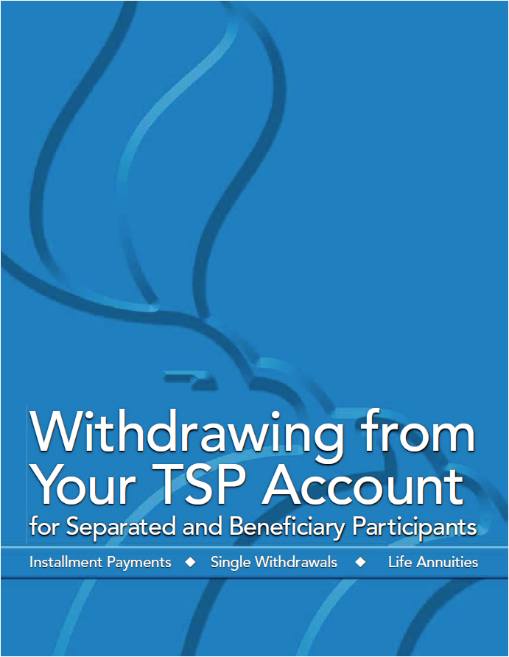
Thrift Savings Plan
Obtain a copy of the TSP booklet:
“Withdrawing from Your TSP Account for Separated and Beneficiary Participants”
https://www.tsp.gov/PDF/formspubs/tspbk02.pdf
Notes:
http://apps.opm.gov/Listserv_Apps/list-sub.cfm

Slide 146
Any Questions about TSP?

Slide 147
Social Security
To create your own social security account on-line and get your estimate, go here:
https://www.ssa.gov/myaccount/

Slide 148
Social Security Full Retirement
Age to Receive full Social Security Benefits:
Age Year of Birth
66 1943-1954
66 and 2 months 1955
66 and 4 months 1956
66 and 6 months 1957
66 and 8 months 1958
66 and 10 months 1959
67 1960 and after

Slide 149
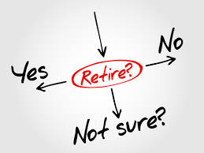
Social Security Early Retirement
You can get Social Security retirement benefits as early as age 62. However, Social Security will reduce your benefit if you retire before your full retirement age.
For example, if you retire at age 62, your benefit would be about 25 percent lower than it would be if you waited until you reach full retirement age.

Slide 150
Social Security Delayed Retirement
You may choose to keep working even beyond your full retirement age. If you do, you can increase your future Social Security benefits in two ways.
Each extra year you work adds another year of earnings to your Social Security record.
Also, your benefit will increase automatically by a certain percentage from the time you reach your full retirement age until you start receiving your benefits or until you reach age 70. The percentage varies depending on your year of birth.
For example, if you were born in 1943 or later, you’ll add 8 percent a year to your benefit for each year you delay signing up for Social Security beyond your full retirement age.

Slide 151
Social Security Early Retirement
Earnings Offset
If you work and get benefits at the same time:
You can continue to work and still get retirement benefits. Your earnings in (or after) the month you reach your full retirement age won’t reduce your Social Security benefits. Social Security will reduce your benefits, however, if your earnings exceed certain limits for the months before you reach full retirement age.
Here is how it works:
If you’re younger than full retirement age, Social Security will deduct $1 in benefits for each $2 you earn above the annual limit ($18,240).
In the year you reach your full retirement age, Social Security will reduce your benefits $1 for every $3 you earn over an annual limit until the month you reach full retirement age. Once you reach full retirement age, you can keep working and your benefit won’t be reduced no matter how much you earn.
Notes:
If you’re younger than full retirement age during all of 2019, Social Security deducts $1 from your benefits for each $2 you earn above $17,640.
If you reach full retirement age during 2019, Social Security deducts $1 from your benefits for each $3 you earn above $46,920 until the month you reach full retirement age.
https://www.ssa.gov/planners/retire/whileworking.html
Although the earnings offset limit is the same for the Special Annuity Supplement and Early Social Security benefits ($17,640 in 2019), the method of offset is not.
Special Annuity Supplement offsets are applied the year following a year of excess earnings.
Early Social Security benefits offsets are applied the same year as the excess earnings, based on estimates
If you work for someone else, only your wages count toward Social Security’s earnings limits.
If you’re self-employed, Social Security counts only your net earnings from self-employment.
For the earnings limits, Social Security does not count income such as other government benefits, investment earnings, interest, pensions, annuities, and capital gains.
Social Security Taxation
If you file a federal tax return as an “individual,” and your combined income is between $25,000 and $34,000, you may have to pay taxes on up to 50 percent of your Social Security benefits. If your combined income is more than $34,000, up to 85 percent of your Social Security benefits is subject to income tax.
If you file a joint return, you may have to pay taxes on 50 percent of your benefits if you and your spouse have a combined income that is between $32,000 and $44,000. If your combined income is more than $44,000, up to 85 percent of your Social Security benefits is subject to income tax.
If you’re married and file a separate return, you probably will pay taxes on your benefits.

